Slide 1
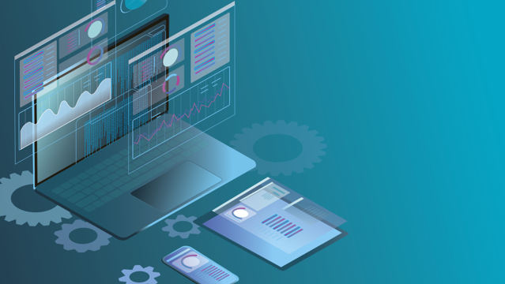
Personalized and Adaptive Learning
Giancarlo Perez
Patricia Peterson-Bland
Filiz Zeybek
EDTC 805 Cross Discipline Studies
Dr. Laura Zieger

Slide 2

Personalized and Adaptive Learning
Origins of Adaptive Learning
Benefits and Challenges
Application in Learning
Future of Adaptive Learning

Slide 3

ORIGINS OF ADAPTIVE LEARNING
WHAT IS ADAPTIVE LEARNING?
Notes:
Welcome! I am going to give you an overview of the origins of adaptive learning.

Slide 4
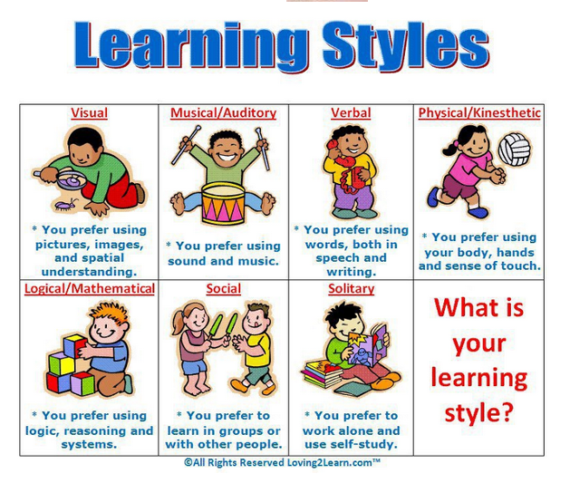

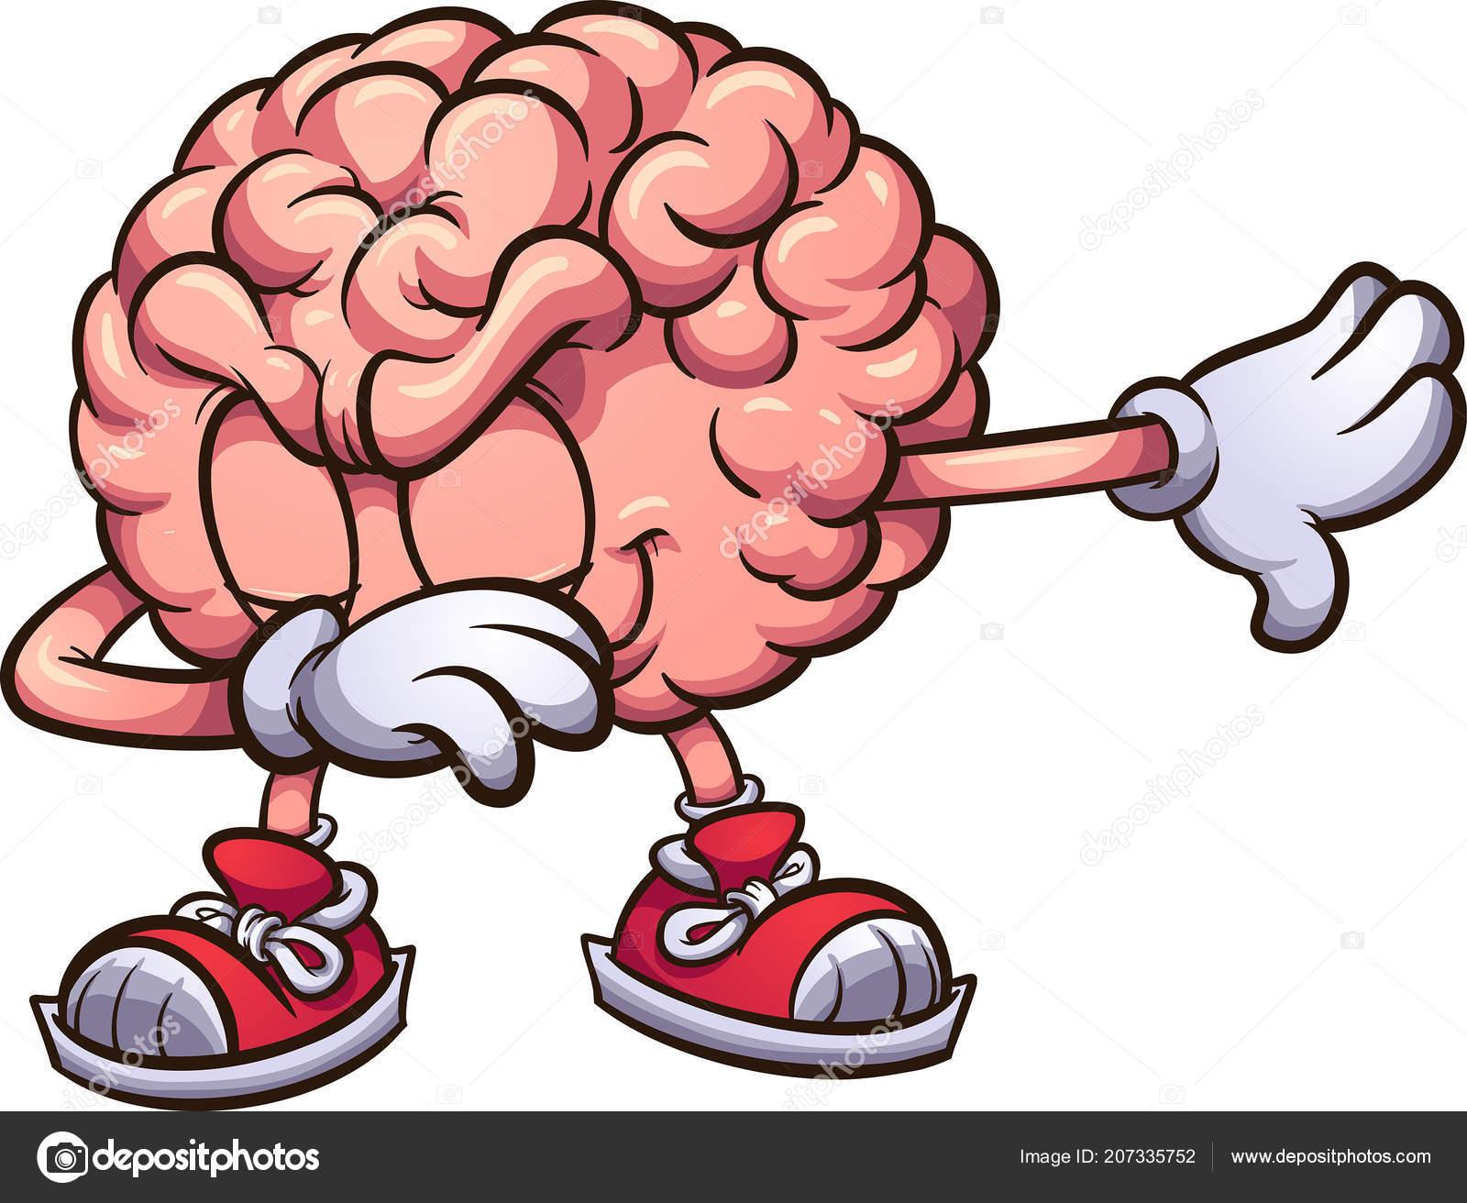
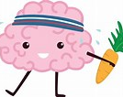
WHO WAS B.F. SKINNER?
Notes:
Psychologist B.F. Skinner began working on ideas of human behavior after earning his doctorate from Harvard. The first instance of what would become adaptive learning was conceived in the 1950s with the work of behaviorist B.F. Skinner. Skinner developed a teaching machine focused on incremental skill building

Slide 5


It’s Not a Race
Notes:
The 2020 Horizon Report defines adaptive learning as the optimization of instruction by modifying the pace of learning and the instructional approach for the needs of each learner relying heavily on the use of adaptive technology (EDUCAUSE, 2020, p. 14).

Slide 6

Notes:
What type of learner are you?

Slide 7

TECHNOLOGY
1970’s
Notes:
in the 70's the main barrier was the cost and size of the computers, rendering the widespread application impractical. Another hurdle in the adoption of early intelligent systems was that the user interfaces were not conducive to the learning process.
Slide 5 Adaptive learning-has its origins in the artificial-intelligence movement and began gaining popularity in the 1970s. At that time, it was commonly accepted that computers would eventually achieve the human ability of adaptivity.

Slide 8
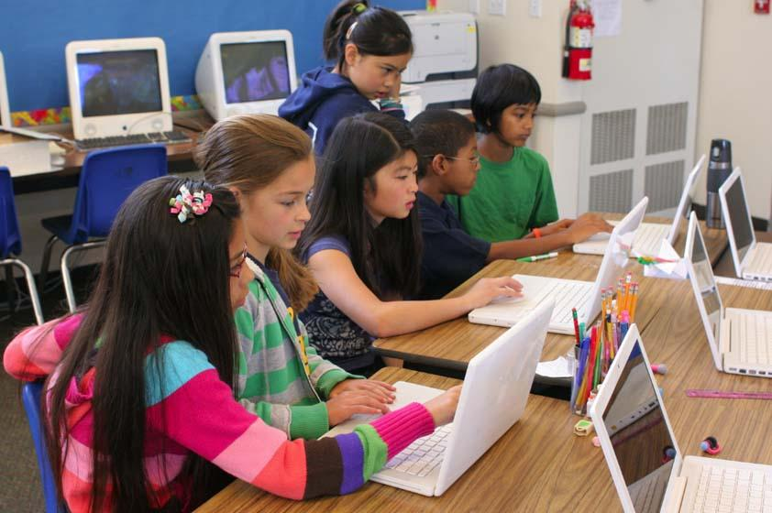
Adaptive Learning (AL) individualize instruction
Notes:
What we recognize as adaptive learning technology has its roots in the artificial intelligence movement in the 1970s.

Slide 9
Adaptive Learning
The Basic Premise
Notes:
Adaptive Learning
or intelligent tutoring has its origins in the artificial-intelligence movement and began gaining popularity in the 1970s. At that time, it was commonly accepted that computers would eventually achieve the human ability of adaptivity. is that the tool or system will be able to adjust to the student/user's learning method, which results in a better and more effective learning experience for the user.

Slide 10
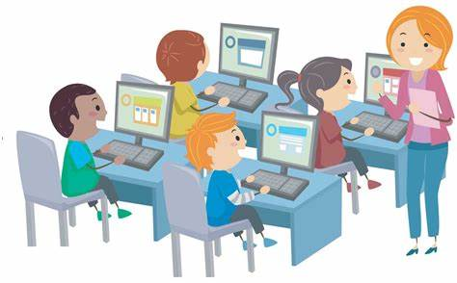
Adaptive learning, also known as adaptive teaching,
Educational impact
Notes:
Adaptive learning, also known as adaptive teaching,
is an educational method which uses computer algorithms to orchestrate the interaction with the learner and deliver customized resources and learning activities to address the unique needs of each learner. In professional learning contexts, individuals may "test out" of some training to ensure they engage with novel instruction.

Slide 11
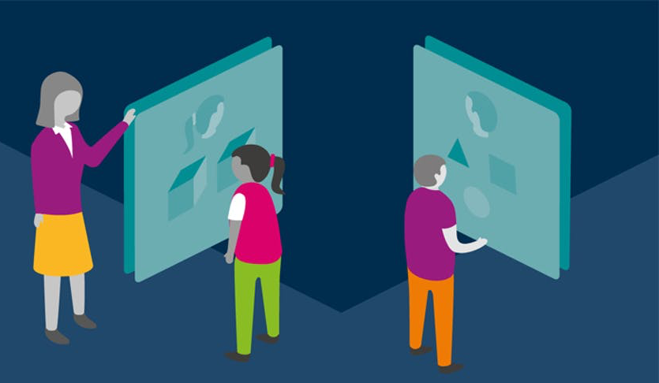


LET’S MAKE IT PERSONAL
Notes:
Adaptive learning is about making learning personal. It enables educators to help their students learn better and achieve learning outcomes through personalization. As both teachers and students usually use some kind of learning management software for adaptive learning, the teachers can analyze the data and understand each student’s individual needs better than ever.

Slide 12

DEFINITION OF ADAPTIVE LEARNING
Notes:
Appearance/Form: How the learning actions—such as content, the addition of text, graphics, and/or video, etc.—are displayed to the learner. Most of today’s adaptive platforms call this “content consumption” and expect knowledge to be obtained by simply reading the content.
Order/Sequence: How the learning actions are ordered and branched depending on the learning progress, such as pathways.
Guidance towards Goal/Mastery: Actions of the system that lead a learner towards success. This allows for changes according to the most optimal learning outcomes, level of difficulty, and the learner’s increasing knowledge or skill level.

Slide 13
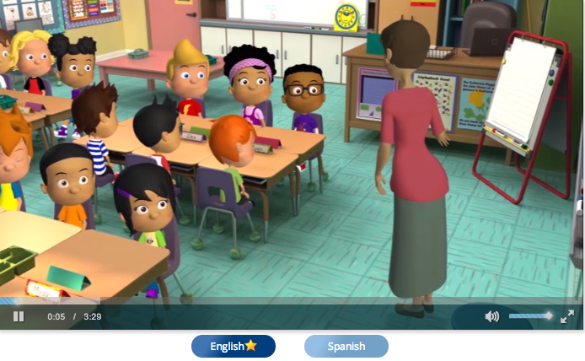

Notes:
It’s about Exploration
At its core, adaptive learning allows students to select the steps or pathways they want to pursue rather than having it dictated to them. Effective technology can assemble and adapt the whole learning management system, not just a single piece of content at a time

Slide 14
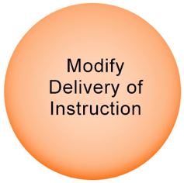
This Photo by Unknown Author is licensed under CC BY-NC-ND
Notes:
Personalized recommendation system has been widely adopted in E-learning field that is adaptive to each learner’s own learning pace.
With full utilization of learning behavior data, psychometric assessment models keep track of the learner’s proficiency on
knowledge points, and then, the well-designed recommendation strategy selects a sequence of actions to meet the objective of maximizing learner’s learning efficiency. Adaptive technology modifies (a) how the content is delivered (audio, video, text), (b) when the content is delivered, creating personalized pathways, and (c) progress towards mastery, making

Slide 15

AL- Enhancing Student Learning Outcomes
.
Notes:
The application of student learning styles in the adaptive learning system to differentiate content has the potential to enhance student learning outcomes and develop skills needed at various levels of success.

Slide 16

BENEFITS AND LIMITATIONS OF PERSONALIZED AND ADAPTIVE LEARNING

Slide 17
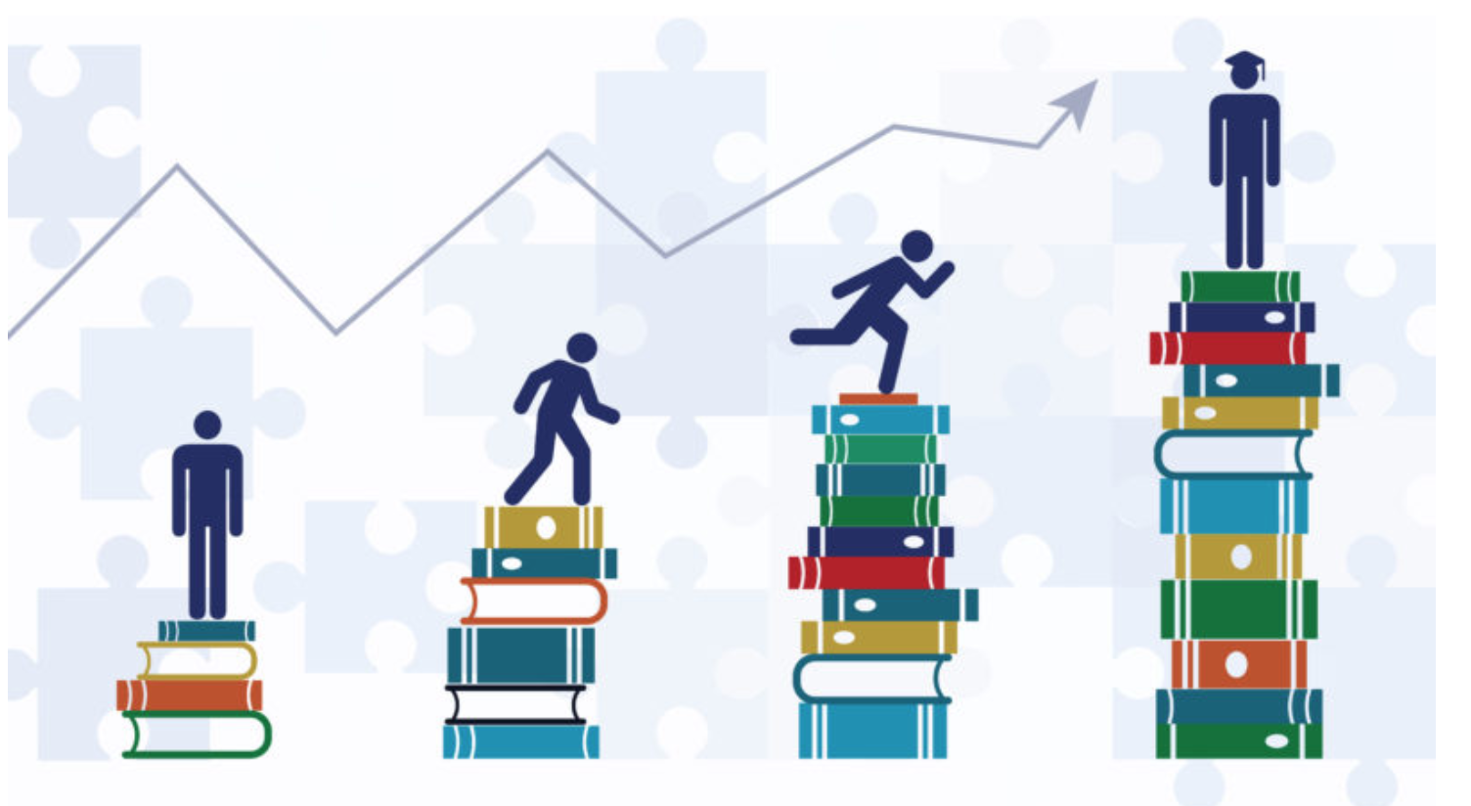
BENEFIT 1
Faster and Higher Quality Student Progression
Notes:
According to DreamBox Learning (2013), there are six major benefits of Adaptive learning in Education. The first one is faster and higher quality student progression. For teachers dealing with ever-expanding class sizes, it may seem like there are not enough hours in the day to give all of their students the individualized attention that they need. Having more students in the classroom is difficult to find the time to create a broad enough lesson to address the needs of each student and check-in with every pupil to make sure he or she truly understands the lesson. With adaptive learning, teachers can use the time students spend with the computer software to address their needs one-on-one or in a small group setting.

Slide 18
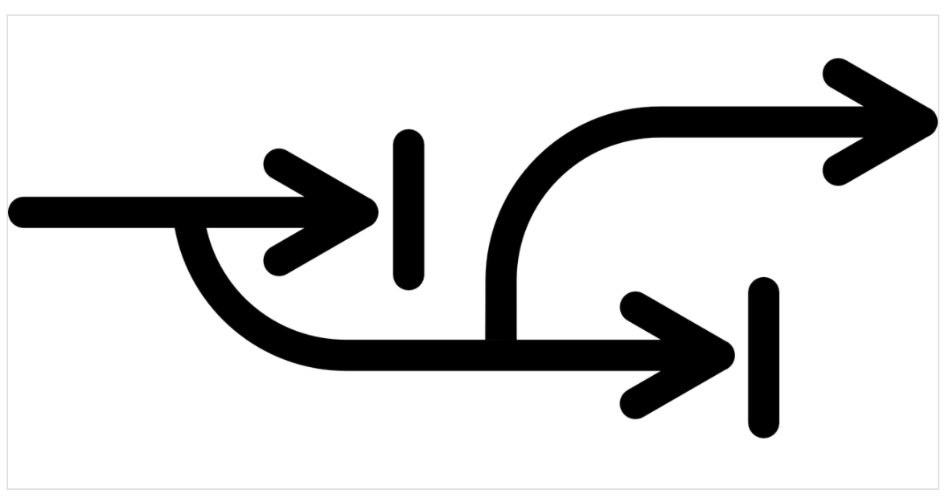
BENEFIT 2
Adapts to Different Abilities
Notes:
Adapts to different abilities: One of the most important educational innovations that have come from adaptive learning is immediately changing instruction based upon a student’s knowledge. As each student works with the program, the technology will pick up on what they are mastering or still struggling with and adjust instruction in real-time.

Slide 19

BENEFIT 3
Improves Understanding
Notes:
Improves understanding: When teachers are standing in front of a classroom, it can be difficult to know whether the students really get the subject. With adaptive learning, the method and pace of instruction are customized for each student, improving their chances of truly understanding new academic concepts.

Slide 20

BENEFIT 4
Engages Students
Notes:
Engage Students: Today, for many K-12 students, technologies have always been a part of their lives. As a result, they are particularly tech-savvy and may become more engaged in their lessons if given a chance to spend part of class time on the computer using adaptive learning programs.

Slide 21

BENEFIT 5
Allows Students To Work At Different Paces
Notes:
Allow students to work different paces: Think a traditional classroom, a teacher stands up at the front, talking about new material. At the same time, students of differing academic abilities sitting rows of desks and attempt to digest everything all at once. When instruction is constructed in this way, all students are expected to learn at the same pace. This makes it difficult for teachers to give struggling learners the extra time they need while challenging high-achievers. With adaptive learning technology, students’ answers are analyzed in real-time, and the software adjusts instruction accordingly. In this way, kids can work at different paces and achieve the best possible academic outcomes.

Slide 22

BENEFIT 6
Frees Up Time For One-on-one Instruction
Notes:
Frees up time for one to one instruction: When adaptive learning programs are implemented in classrooms, they can free up time for teachers to give students one-on-one instruction. Adaptive learning software customizes the learning presentations and constantly monitors and analyzes students' responses, which gives teachers access to valuable data. This data gives teachers insight into whether or not students are truly grasping new concepts, and whether particular kids in their classrooms could benefit from one-on-one instruction. This individual attention can happen while other students work with computers or implement a model of blended learning.

Slide 23
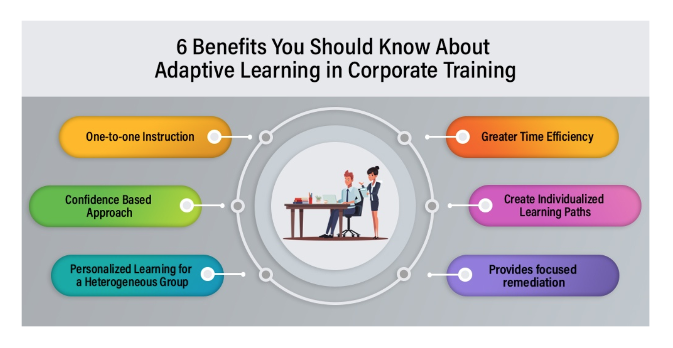
BENEFIT 7
Advantages for Corporate Training
Notes:
Next, I want to talk about the 6 benefits of adaptive learning in Corporate training.
- One-To-One Instruction
- Greater Time Efficiency: Adaptive learning helps learners spend half the amount of time they take in a standard course if they clearly understand the concepts.
- The confidence-Based Approach: Adaptive learning utilizes a confidence-based assessment methodology to test the learners' current understanding.
- Create Individualized Learning Paths
- Personalized Learning For A Heterogeneous Group
- Provides Focused Remediation: Instead of wasting time over-studying topics learners have mastered or under-studying concepts they haven’t yet grasped, adaptive learning in corporate training helps learners focus on weak areas with efficient remediation.

Slide 24

CHALLENGE 1
Moving Ahead Without Evidence
Notes:
Freda (2016) stated that six challenges are encountered when instructors implement adaptive learning in education.
Moving ahead without evidence: Adaptive learning programs are a new extension in education. Due to this aspect, there is no huge pool of research studies that prove strongly in its effectiveness. Many higher-level educators at Universities around the world have moved ahead and spent a lot of money developing the algorithms for online adaptive learning programs or the purchase of them even without a huge pool of background evidence that proves the effectiveness without question.

Slide 25
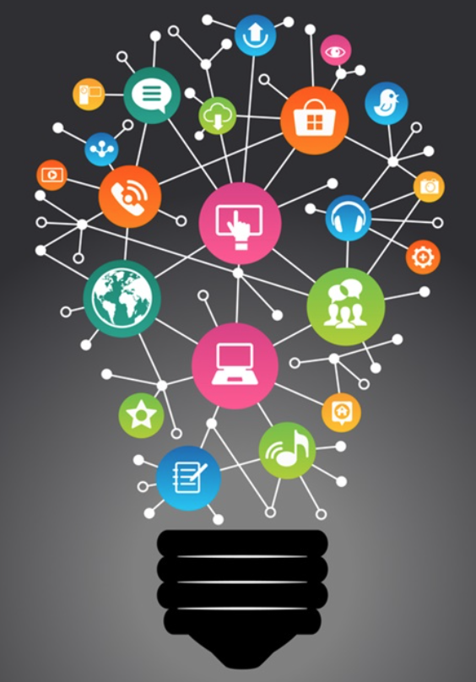
CHALLENGE 2
Finding Resources For Development
Notes:
Finding resources for development: Adaptive learning programs for educational institutions to use and create are very expensive. Many Universities are partnering with the Gates Foundation in the creation of these adaptive learning programs that utilize algorithms to tailor virtual-based instruction to adapt to the learner's specific needs. However, other educational institutions are taking a risk and using adaptive learning programs that still don’t have extensive backgrounds of evidence that prove their effectiveness.

Slide 26
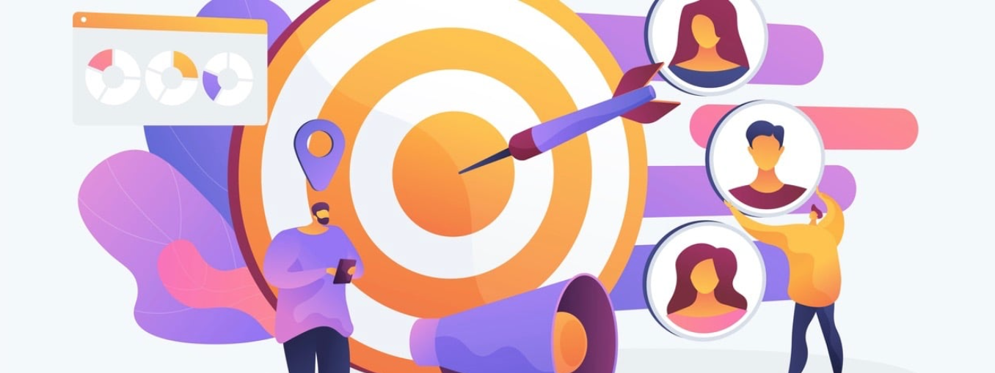
CHALLENGE 3
Winning Over Instructors And Students
Notes:
Winning over instructors and students: “The future of learning will move teaching from delivering information to managing learning” (Freda, 2016). Adaptive learning requires a determined instructor willing to move away from traditional teaching and focus their instruction on intervention and student fulfillment of adaptive learning tasks through adaptive learning programs. A lot of educators are unwilling or nervous when it comes to changing their instruction. Also, students must master topics to move onto the next topics within the program. This requires a lot of dedication from students to master topics. If students struggle to reach the mastery level, they could become unmotivated.

Slide 27

CHALLENGE 4
Selecting The Right Team Or Provider
Notes:
Selecting the right team or provider: There are many adaptive learning providers and programs. Since most programs cost a large sum of money to purchase for large educational institutions, selective the right provider can become stressful and time-consuming.

Slide 28

CHALLENGE 5
Managing Extensive Data
Notes:
Managing extensive data: As stated earlier, adaptive learning moves from having the instructor be the deliverer/grader of material. The instructor now becomes the learning manager, and the analyst of adaptive learning program generated data. Most educators did not go to school to become data analysts. This now poses the issue of educating instructors on analyzing data and adaptive learning program generated data and patterns of student learning.

Slide 29
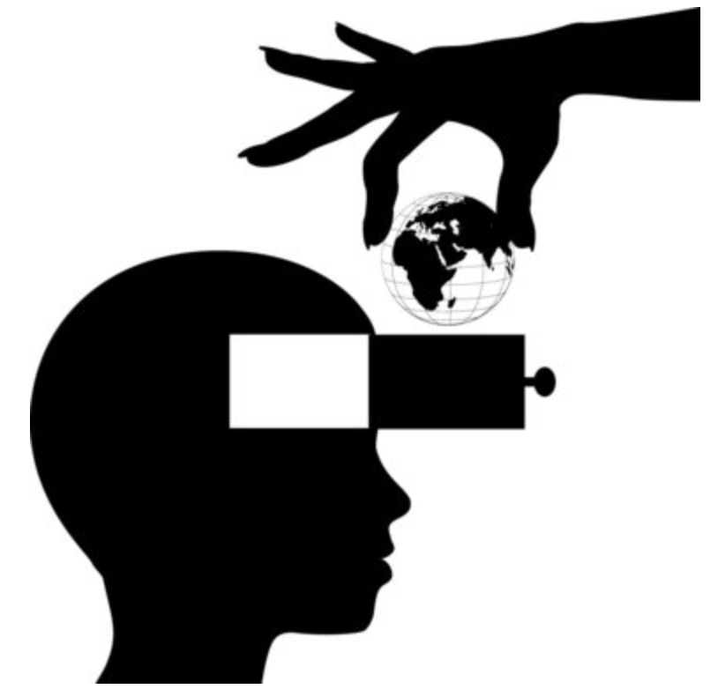
CHALLENGE 6
Understanding That Adaptive Learning Isn’t A Magic Bullet
Notes:
Understanding that adaptive learning isn’t a magic bullet: The educators play an effective role in developing and analyzing the adaptive learning program's data. Some subjects, such as humanities, can’t effectively be taught through adaptive learning programs with algorithms to define mastery. Hence, adaptive learning isn’t a magic technique that instantly has students master every topic.

Slide 30
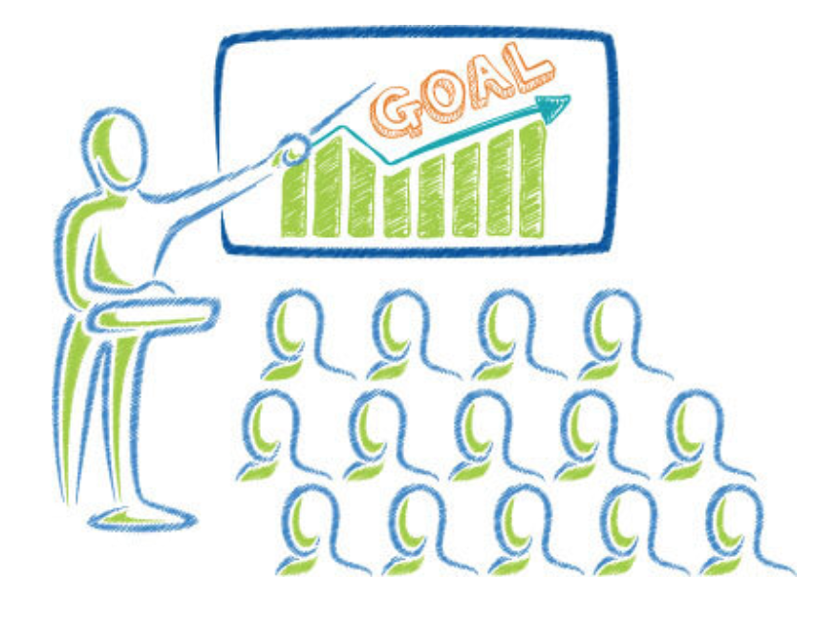
CHALLENGE 7
In-house Expertise and Professional Developments
Notes:
In-house expertise and PDs: So unless the institutions and corporations have the in-house expertise to understand, operate and manage adaptive learning platforms independently, the process of demystifying adaptive learning and making learners adapt to it can be a resource-intensive change-management process in itself and requires extensive professional development.

Slide 31

CHALLENGE 8
Social Innovation
Notes:
Social innovation: It also downplays the importance of social innovation. It requires existing resources within their traditional learning ecosystems to harness the true potential of adaptive learning.

Slide 32


Educational Applications of Personalized and adaptive learning now and future
Notes:
Thank you Filiz for the great overview on the benefits and challenges of Adaptive Learning.
As she mentioned there are many benefits to individualizing education for students, and we can see that in the application of adaptive learning technology in all different levels of education.

Slide 33
Notes:
Adaptive learning technology is being used in the fields of:
-k-12 education
-Tertiary or higher ed
-and the private corporate sector for training and development

Slide 34
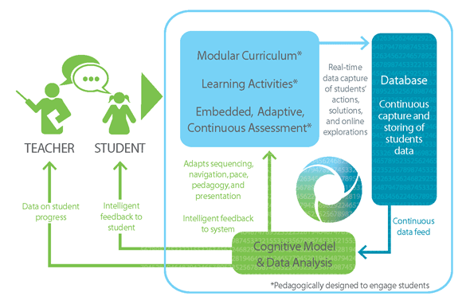
Notes:
As discussed by Patricia, modern adaptive learning technology aims to improve student learning by Using the continuous expanding database on student’s preference to deliver content relevant to their needs and provide the instructor with necessary data to personalize student learning plans.

Slide 35
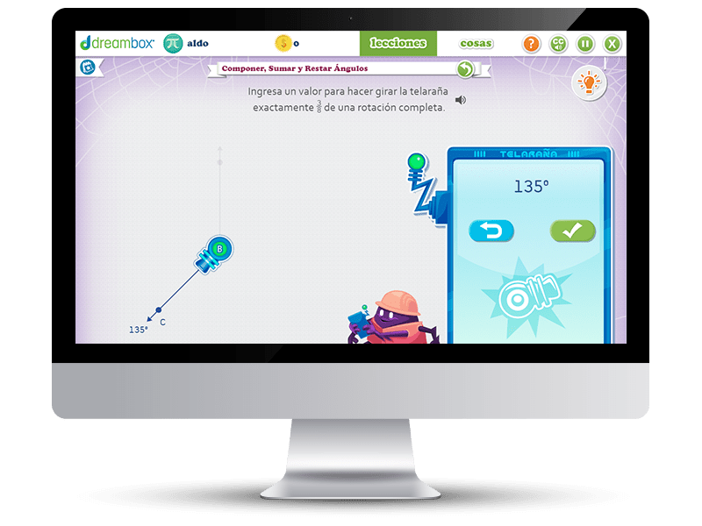
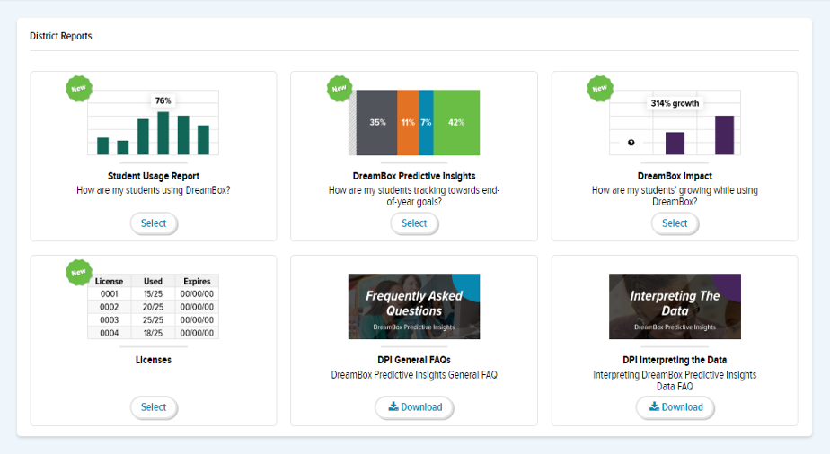
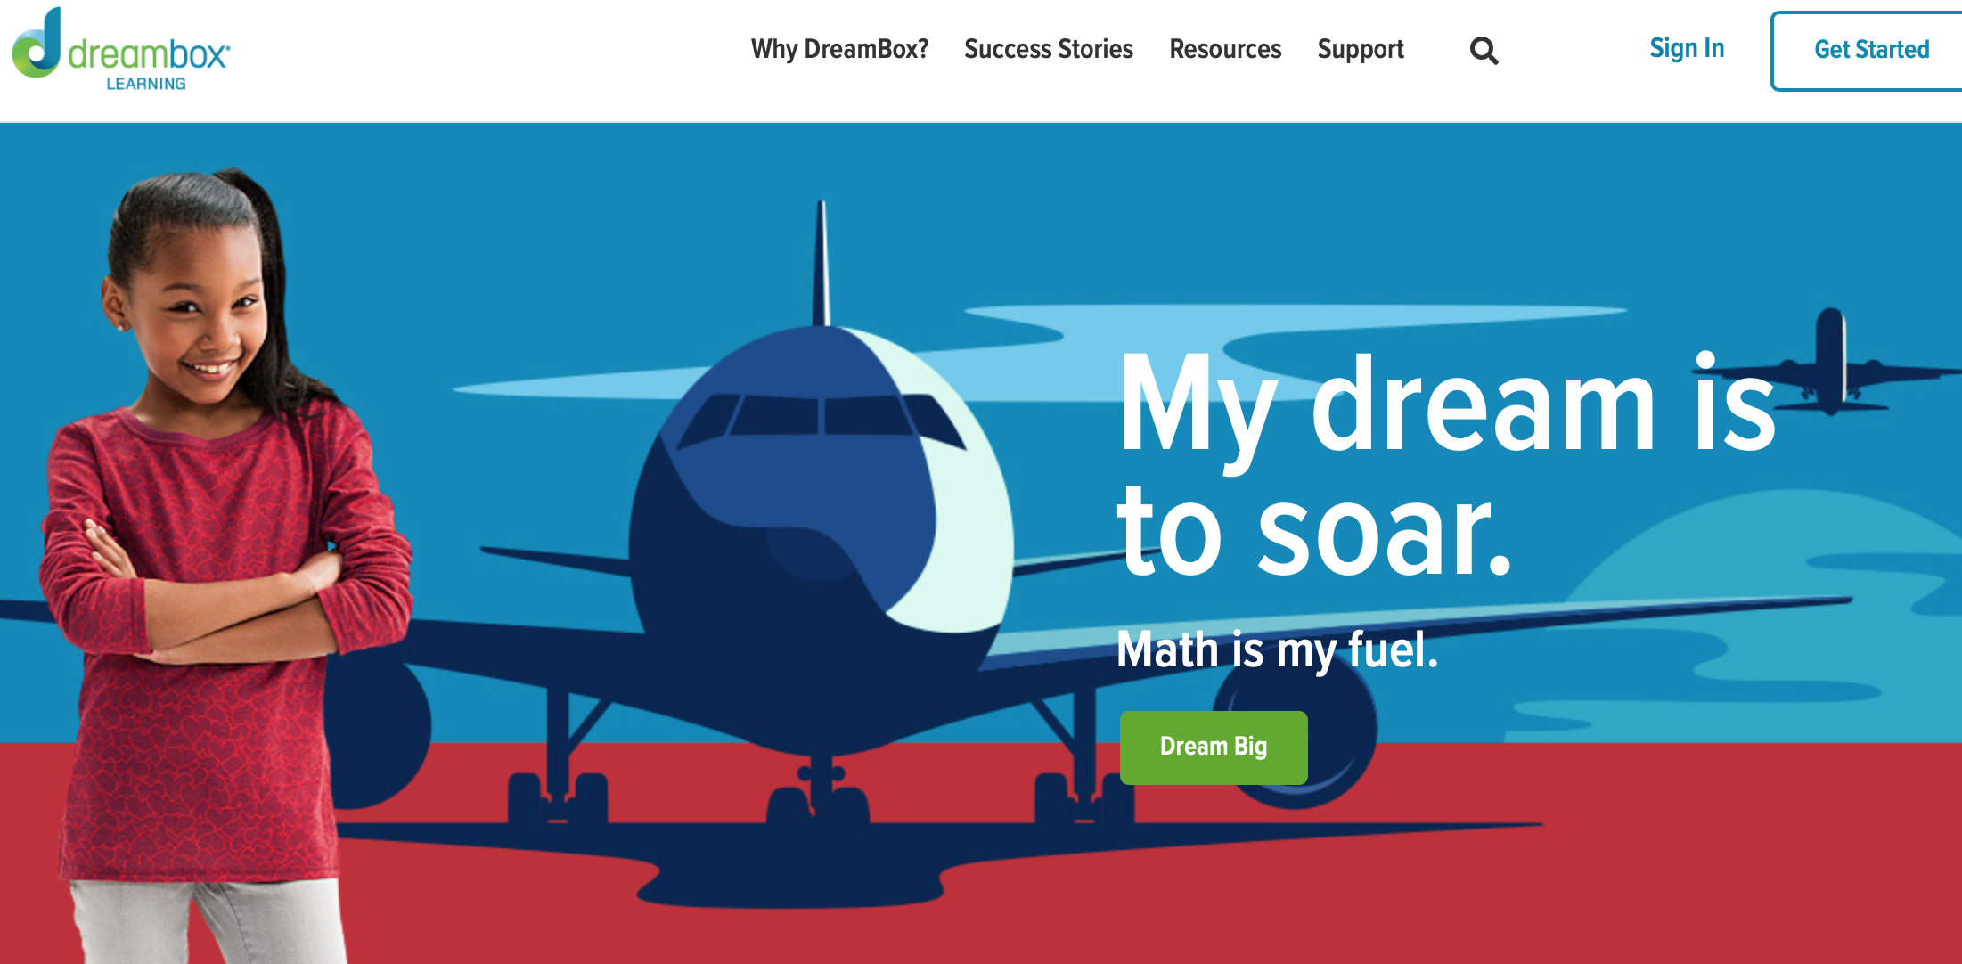
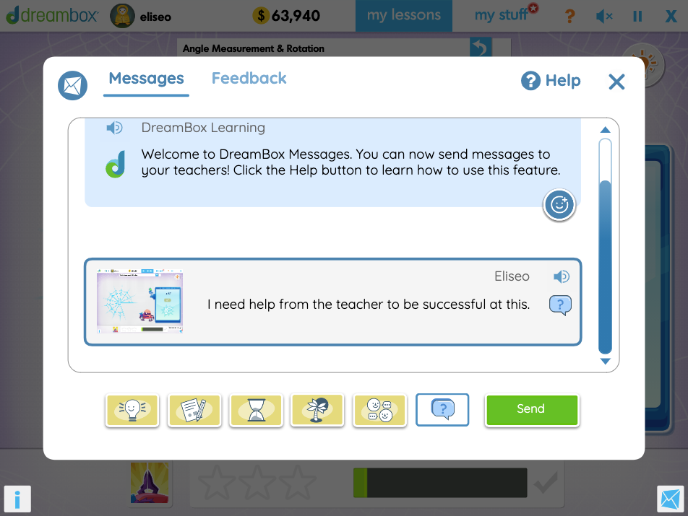
Notes:
In the k-12 system, platforms like DreamBox, a math adaptive learning platform
Provides live feedback and learning pathways for students as they progress through their adaptive program.
This platform also Creates elaborate reports for teachers to help address the shortcoming and misconceptions of students.
Lately, it has been Updated to maximize learning during virtual teaching and facilitating student-instructor communication for difficult concepts.

Slide 36
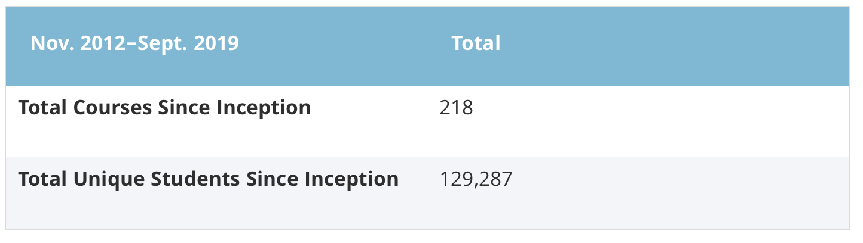
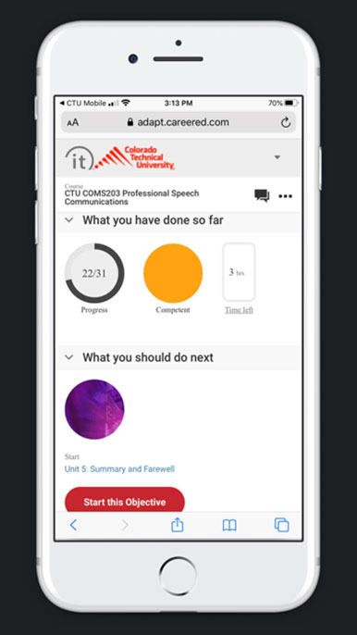
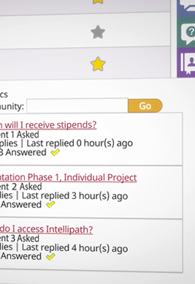
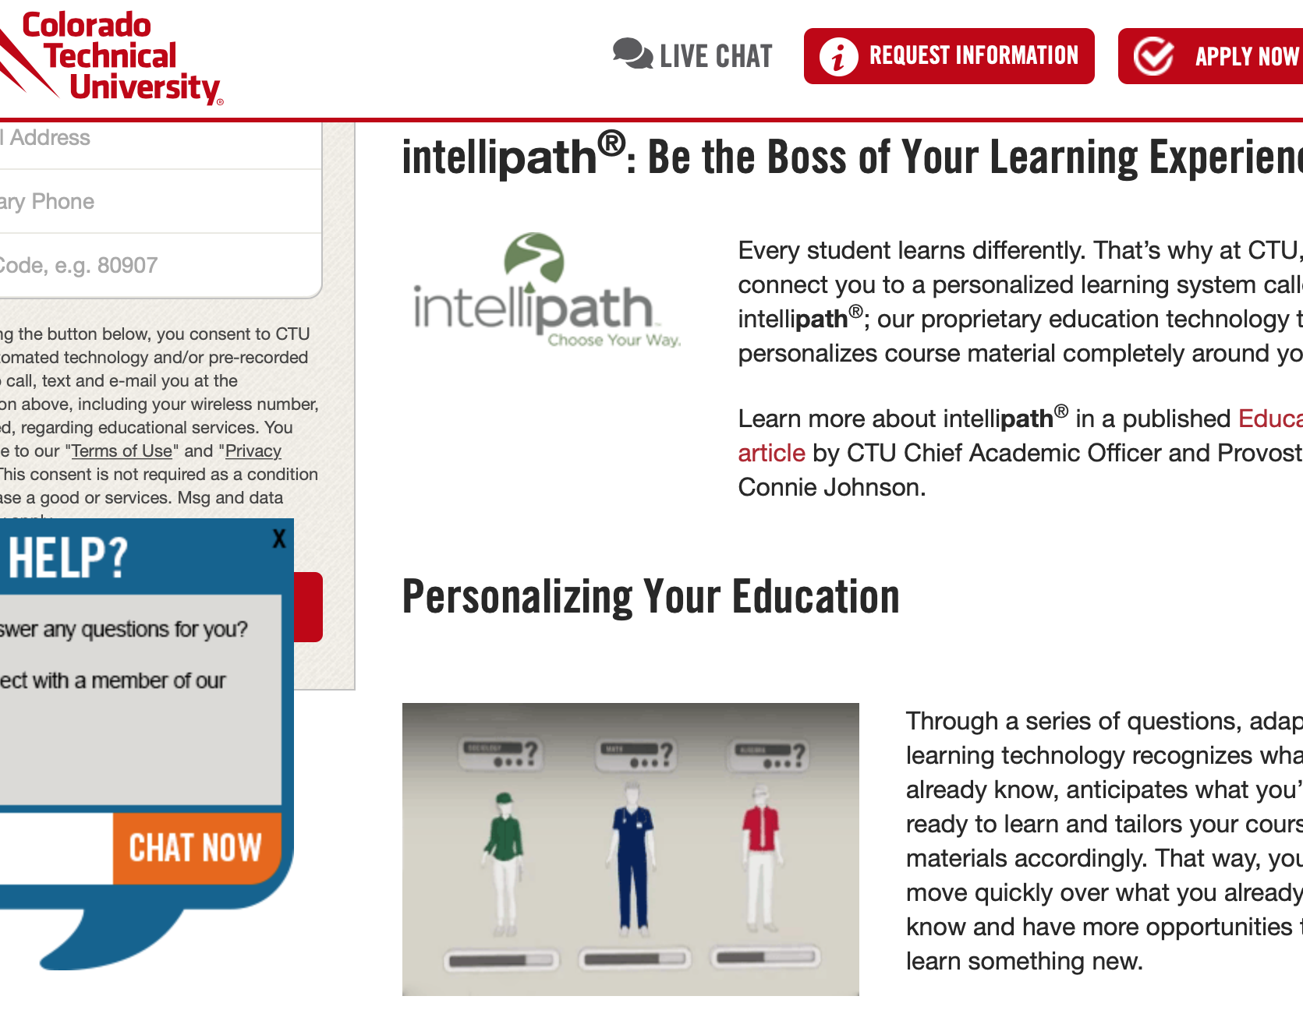
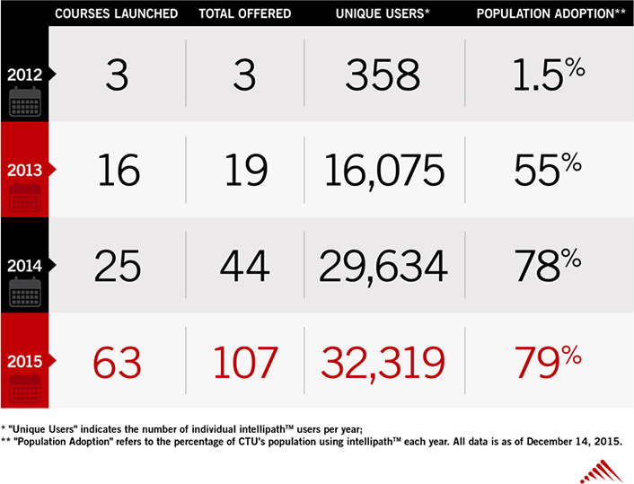
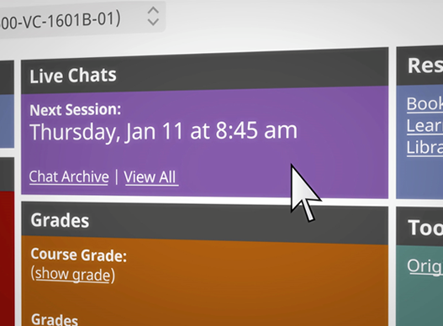
Notes:
Higher education presents the largest work on research about adaptive learning.
As discussed in the 2020 Horizon report, many organizations like the University of Arizona and the university of Colorado have developed adaptive learning platforms to deliver semester long courses for general studies.

Slide 37
Notes:
The university of Colorado has partner with EDUCAUSE to study the impact of adaptive learning courses at the higher education level, from student orientation to complex math courses like Advanced Calculus, showing excellent results.

Slide 38
Notes:
The classes are fully digital and available in multiple platforms.

Slide 39
Notes:
Since its inception, the number of adaptive learning courses has expanded from 3 in 2012 to 63 in 2015 with a total of 79% adoption by the student body.

Slide 40
Notes:
Just a transition slide.

Slide 41
Notes:
And an increase in enrollment of over 129,000 students.

Slide 42

Notes:
Complementing higher education, different certification organizations are providing standardized testing preparation.
Programs like Surgent CPA review use adaptive learning technology to personalize content for future accountants.
It guarantees to address specific weak areas by providing relevant and personalized content to match the certification assessment.

Slide 43
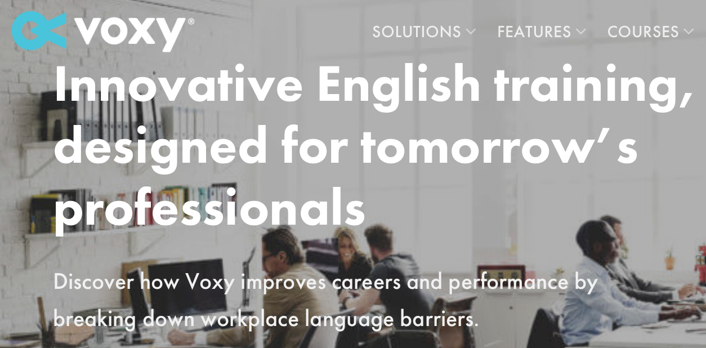
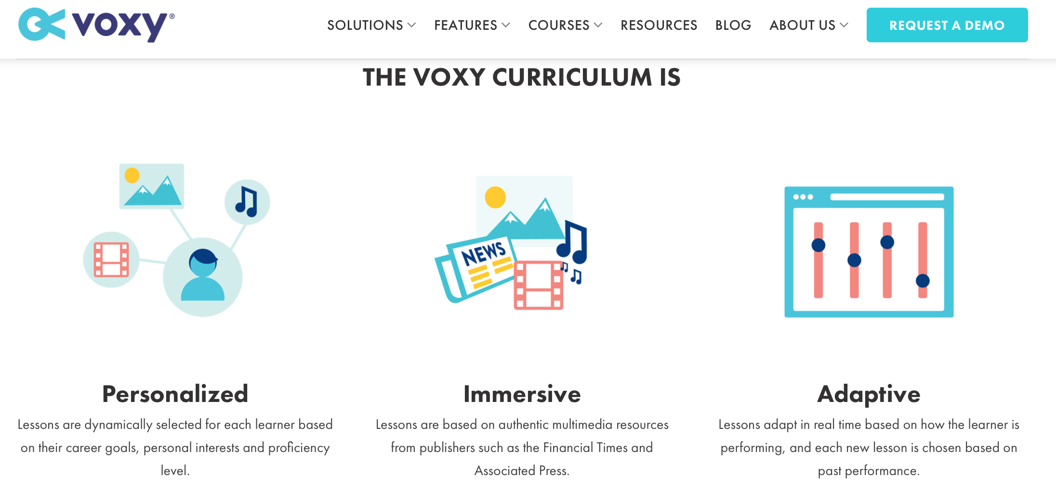
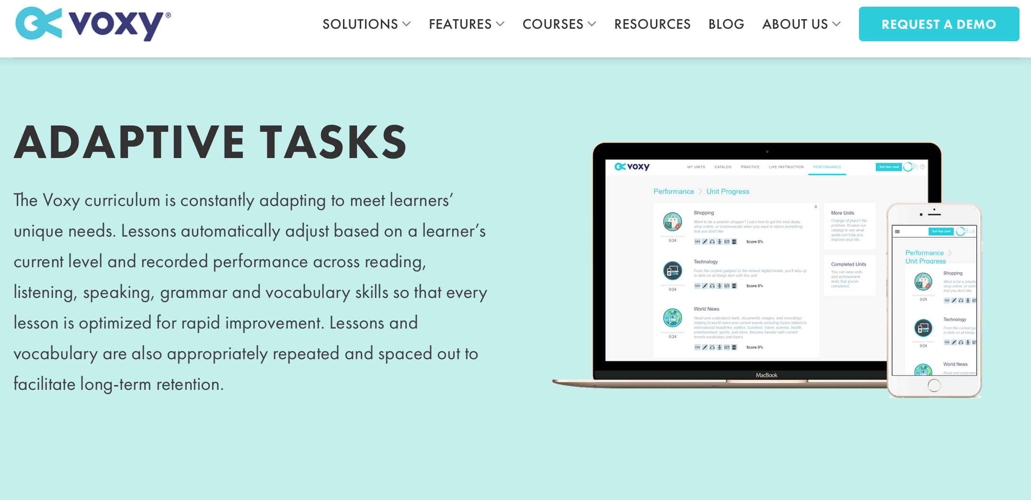
Notes:
Adaptive learning has also impacted the way that corporations train their employees in multiple areas of professional development.
institutions like Voxy aim to breach the communication gap in international business by providing conversational business English classes to international organizations.

Slide 44
Notes:
Their focus is on preparing professionals in all fields to compete in the English-speaking market like the United States.
Companies like International Airlines use Voxy to prepare their employees to communicate with English speaking costumers, and the Major League Soccer (MLS) in the US to prepare their international players to succeed in a different environment.

Slide 45
Notes:
Just a transition slide.

Slide 46
Notes:
Their adaptive learning platform personalizes content relevant to the background and needs of the learner through a personalized assessment

Slide 47
Notes:
Just a transition slide.

Slide 48
Notes:
Artificial Intelligence in their software personalizes the content to make it more relevant to the area of expertise of the learner.

Slide 49
Scoot on Over: ACT Acquires Adaptive Learning Platform ScootPad (EdSurge, 2020).
Notes:
ACT, the Iowa-based nonprofit best known for its college admissions tests, has acquired ScootPad, a known developer of adaptive learning online curricula for K-8 math and English.

Slide 50


Notes:
Similarly Educational giants Pearson acquire SmartSparrow, a platform dedicated to facilitate adaptive learning for institutions.
This shows the push for Pearson to continue pushing the boundaries of education by improving adaptive learning.

Slide 51
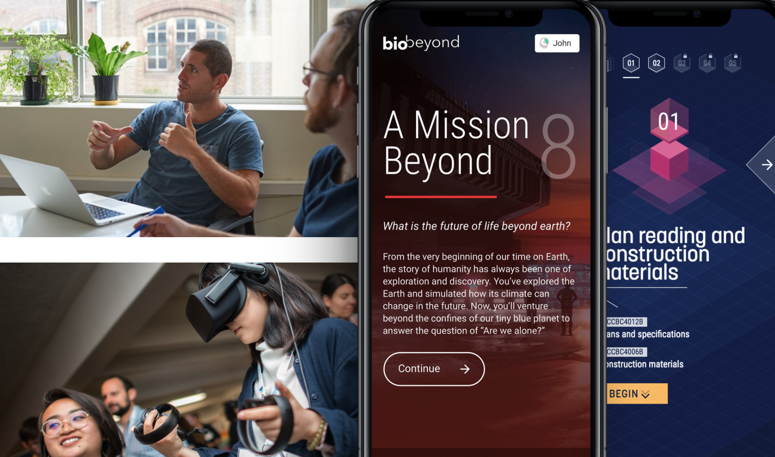
Notes:
Their involvement in all aspects of education, publishing for k-12 and higher ed, standardized test development, and recent interest in global private education prime Pearson to invest in potential revolutionary educational practices.

Slide 52

References
DreamBox. (2013). Six key benefits of adaptive learning.DreamBox Learning. https://www.dreambox.com/blog/six-benefits-of-adaptive-learning
EdSurge. (2020, May 18). Scoot on Over: Act Acquires Adaptive Learning Platform Scootpad. https://www.edsurge.com/news/2020-05-18-scoot-on-over-act-acquires-adaptive-learning-platform-scootpad
EDUCAUSE. (2020). 2020 EDUCAUSE Horizon Report, Teaching and Learning Edition.
https://library.educause.edu/-/media/files/library/2020/3/2020_horizon_report_pdf.pdf
Freda, B. (2016). Clearing the hurdles to adaptive learning: Overcoming six challenges encountered in adopting adaptive learning.
Horn, M. B. (2016, May 10). Empowering Educators Means Decoding Adaptive Learning. EdSurge. https://www.edsurge.com/news/2016-05-10-empowering-educators-means-decoding-adaptive-learning
Johnson, C., & Sloan, A. (2020, April 6). Adaptive Learning: Implementation, Scaling, and Lessons Learned. EDUCAUSE Review. https://er.educause.edu/articles/2020/4/adaptive-learning-implementation-scaling-and-lessons-learned
Kumar, S. (2018). 6 benefits you should know about adaptive learning in corporate training. eLearning Industry. https://elearningindustry.com/adaptive-learning-in-corporate- training-benefits-know
Lopukhina, D. (2020, March 29). Adaptive Learning is the Future of Education. eLearning Industry. https://elearningindustry.com/adaptive-learning-for-schools-colleges
Lynch, M. (2017, August 7). 5 Things You Should Know About Adaptive Learning. The Tech Edvocate. https://www.thetechedvocate.org/5-things-know-adaptive-learning/
McGraw-Hill Education. (2016). The Impact of Connect on Student Success McGraw-Hill Connect® Effectiveness Study. https://learn.mheducation.com/rs/303-FKF-702/images/connect-effectiveness.pdf
Parmley, L. (2019, February 22). 10 Adaptive Learning Examples To Model in Your Online Course. Course Method. https://coursemethod.com/adaptive-learning-examples.html
Smith, T. (2016). How Adaptive Learning Really Works. Tech & Learning, 37(3), 20–26.
Szostak, B. (2018). Adapting to adaptive learning. Chief Learning Officer - CLO Media. https://www.chieflearningofficer.com/2018/01/10/adapting-adaptive-learning/
U.S. Department of Education. (2017). Reimagining the Role of Technology in Education: 2017 National Education Technology Plan Update. https://tech.ed.gov/netp/
Voxy. (2020, February 12). Personalized units. Retrieved October 17, 2020, from https://voxy.com/features/personalized-units/
Wan, T. (2020, January 27). Pearson Bets on Adaptive Learning (Again) With $25M Acquisition of SmartSparrow. EdSurge. https://www.edsurge.com/news/2020-01-22-pearson-bets-on-adaptive-learning-again-with-25m-acquisition-of-smart-sparrow

