Slide 1
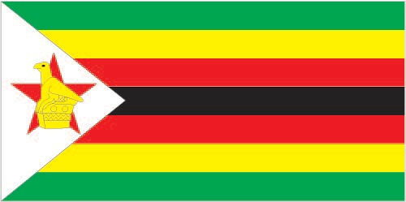
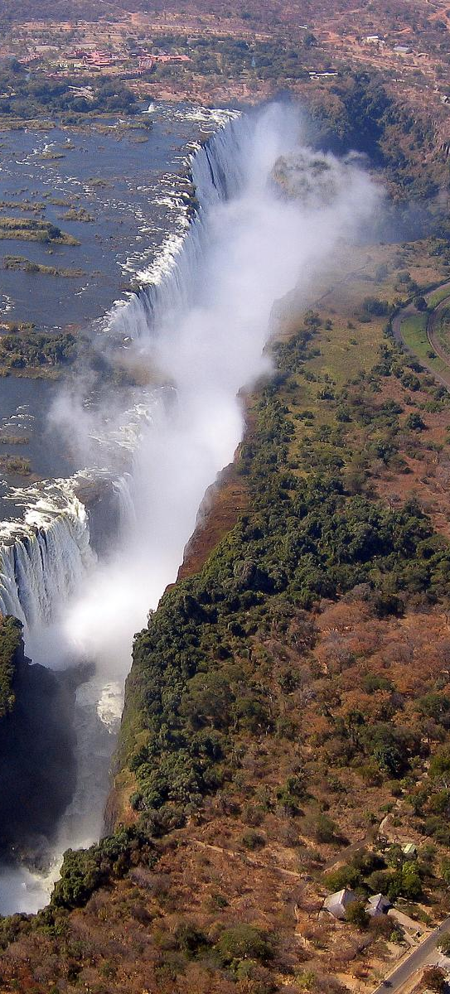
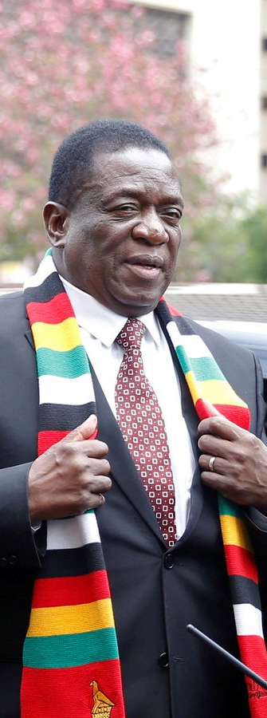
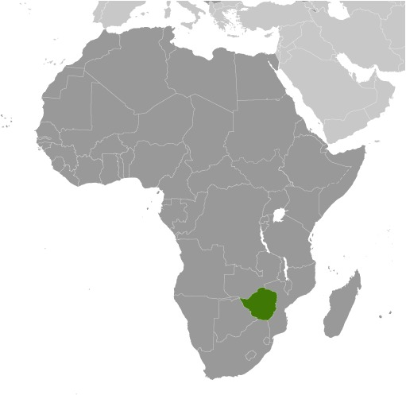
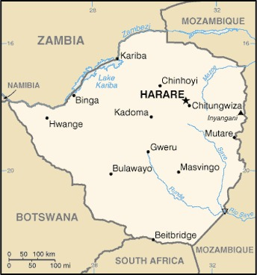
ZIMBABWE - ENVIRONMENTAL SCAN
Giancarlo Perez-Flores・
New Jersey City University・
EDT-C804: Global Issues In Educational Technology Leadership ・
Dr. Christopher Shamburg ・

Slide 2
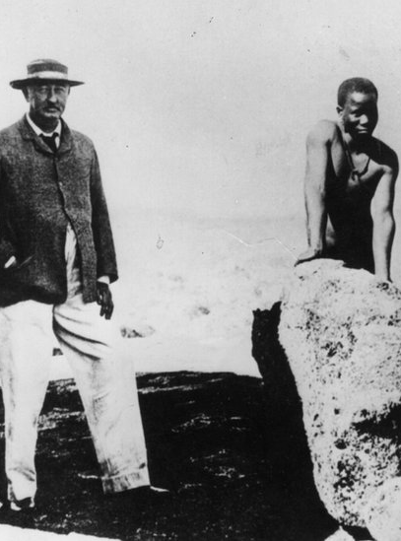
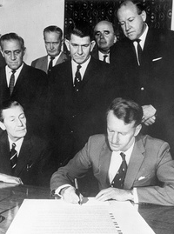
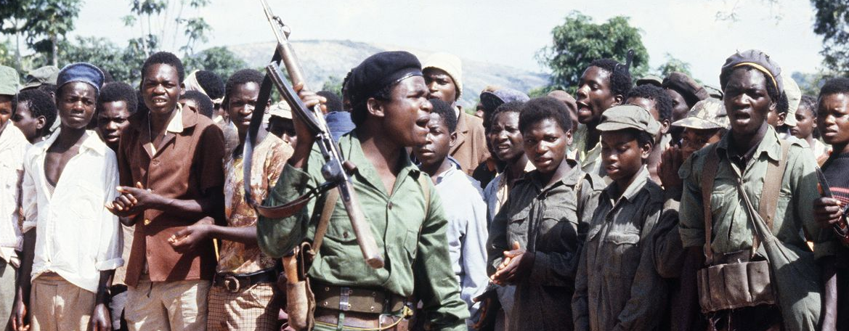
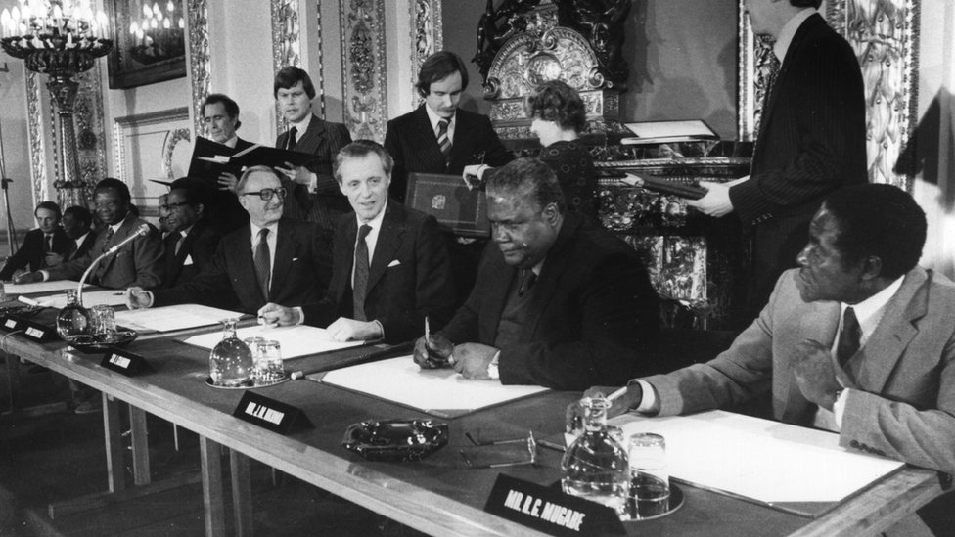
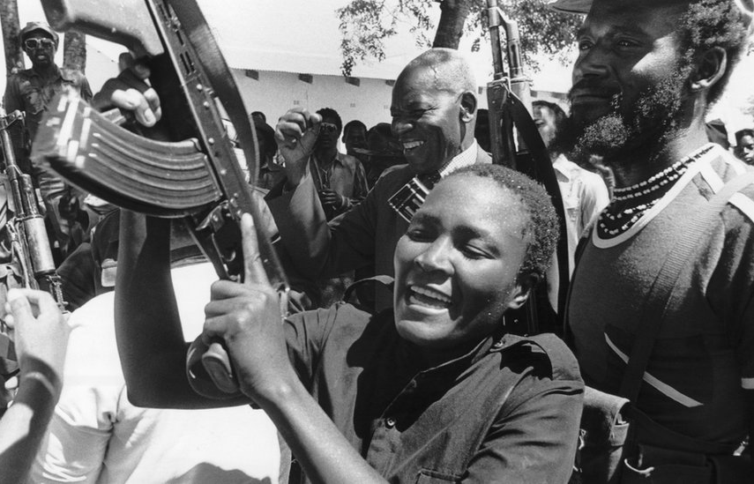

Slide 3
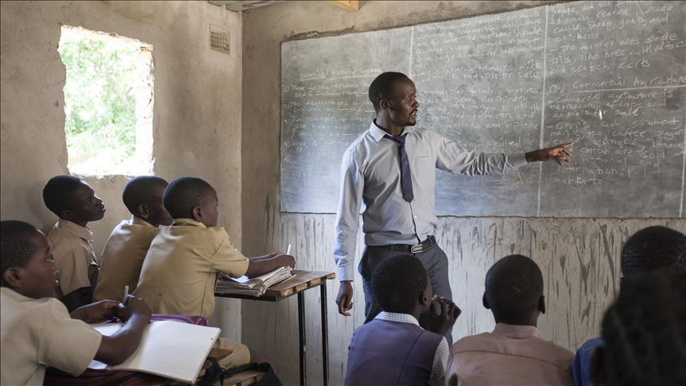
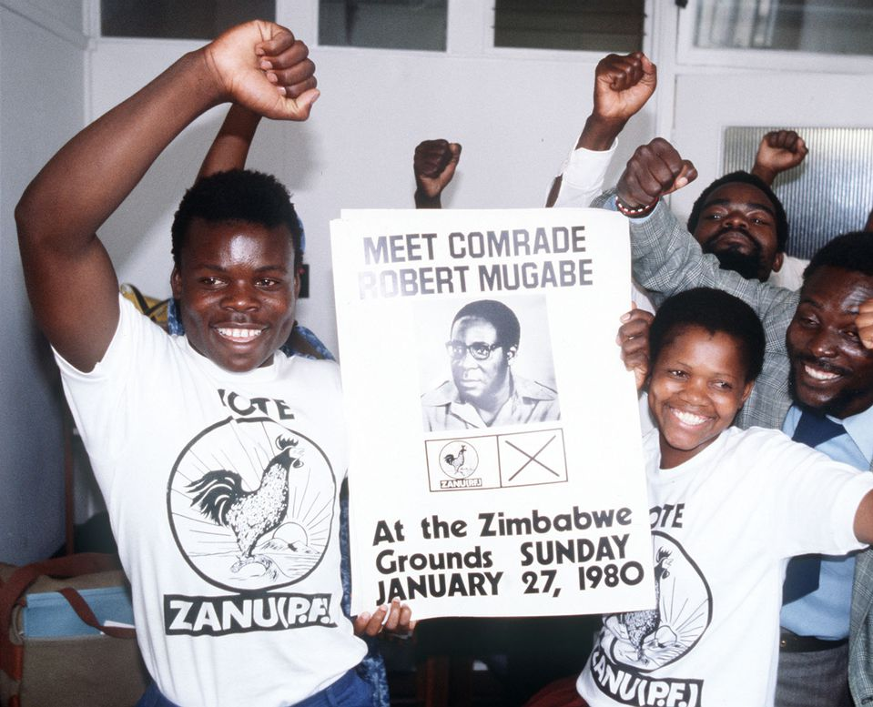
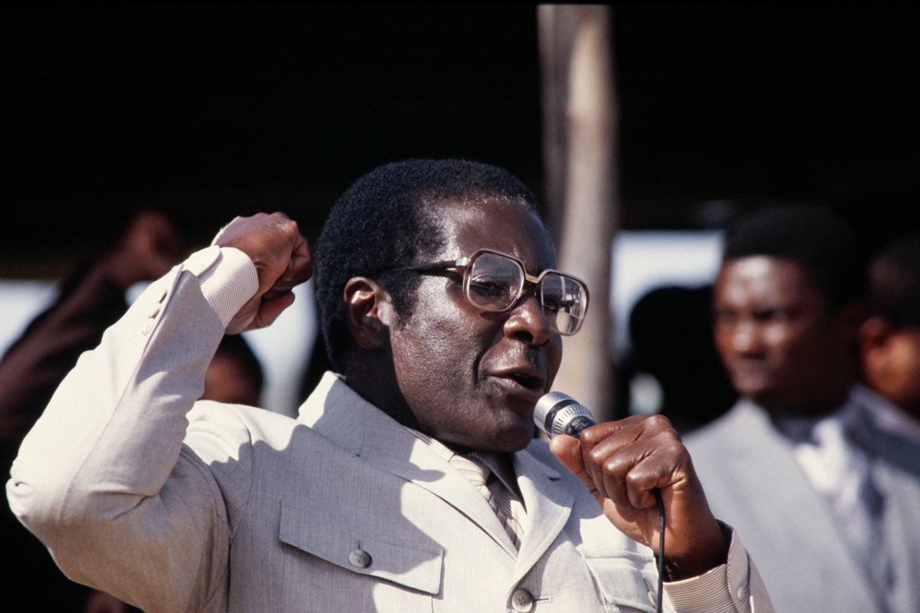
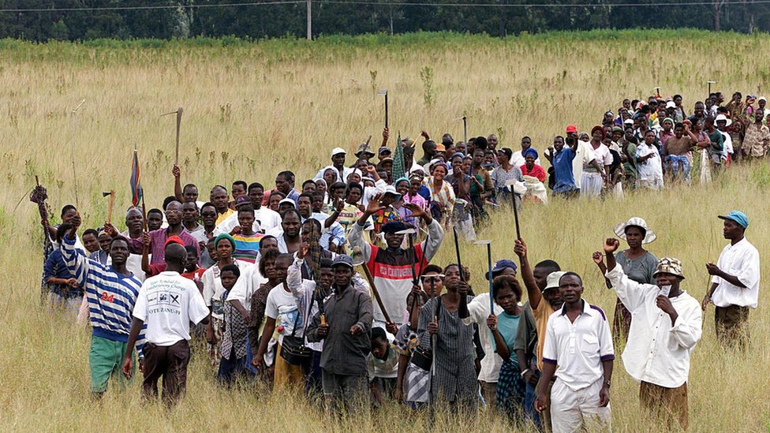
MUGABE
RULING

Slide 4
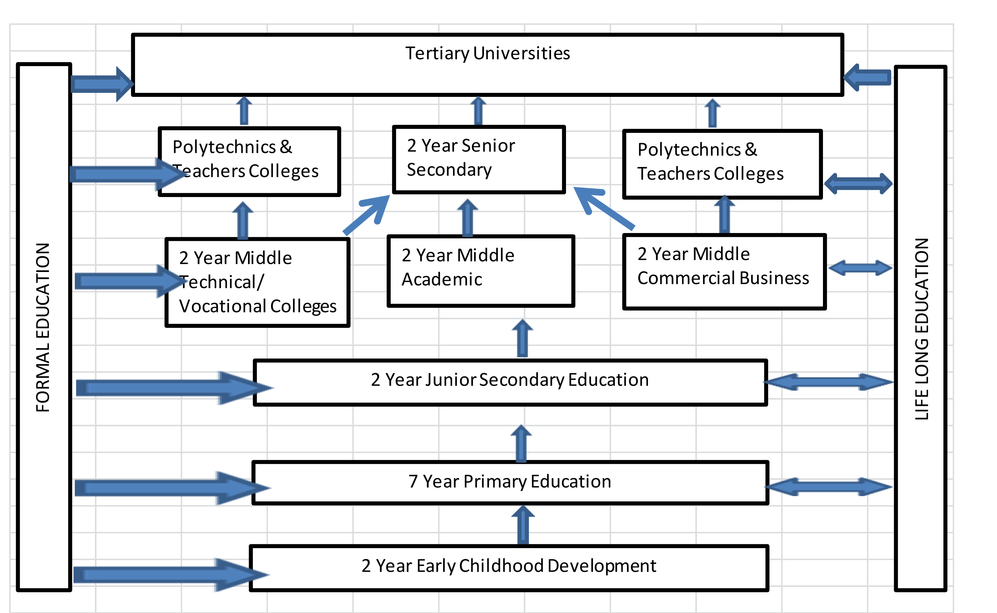

Slide 5
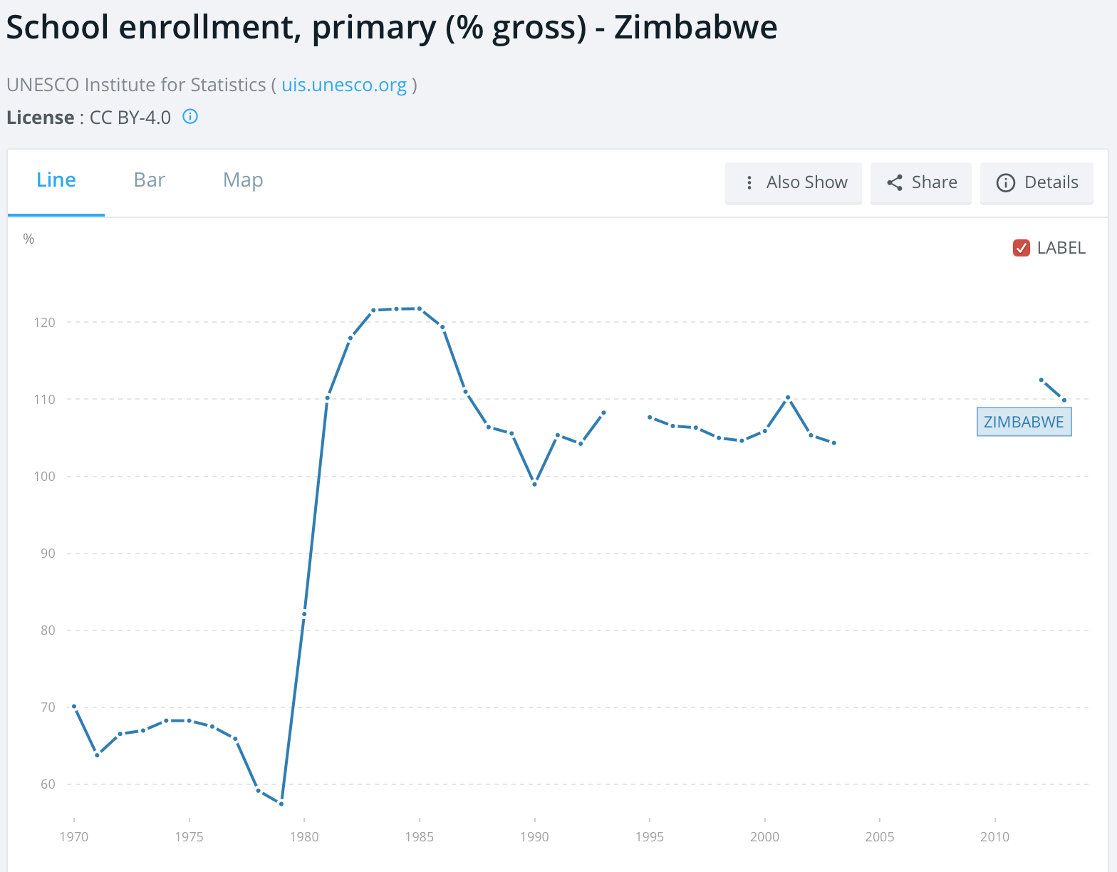
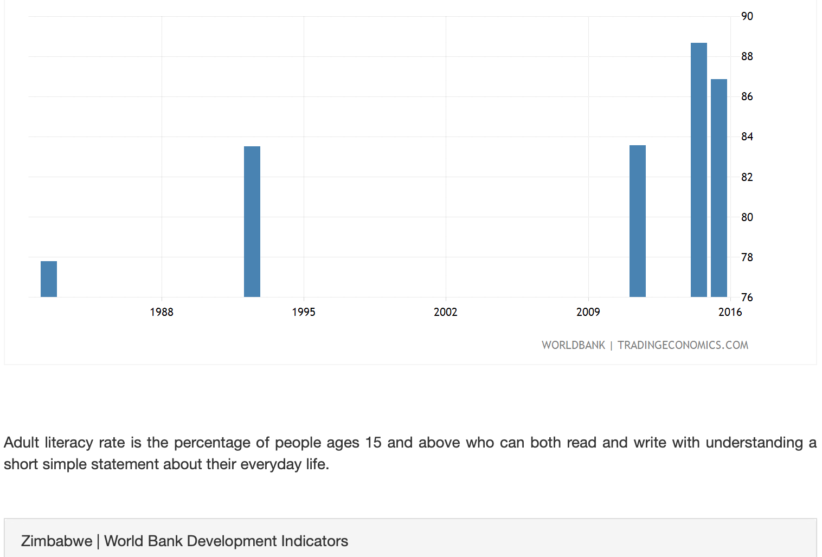
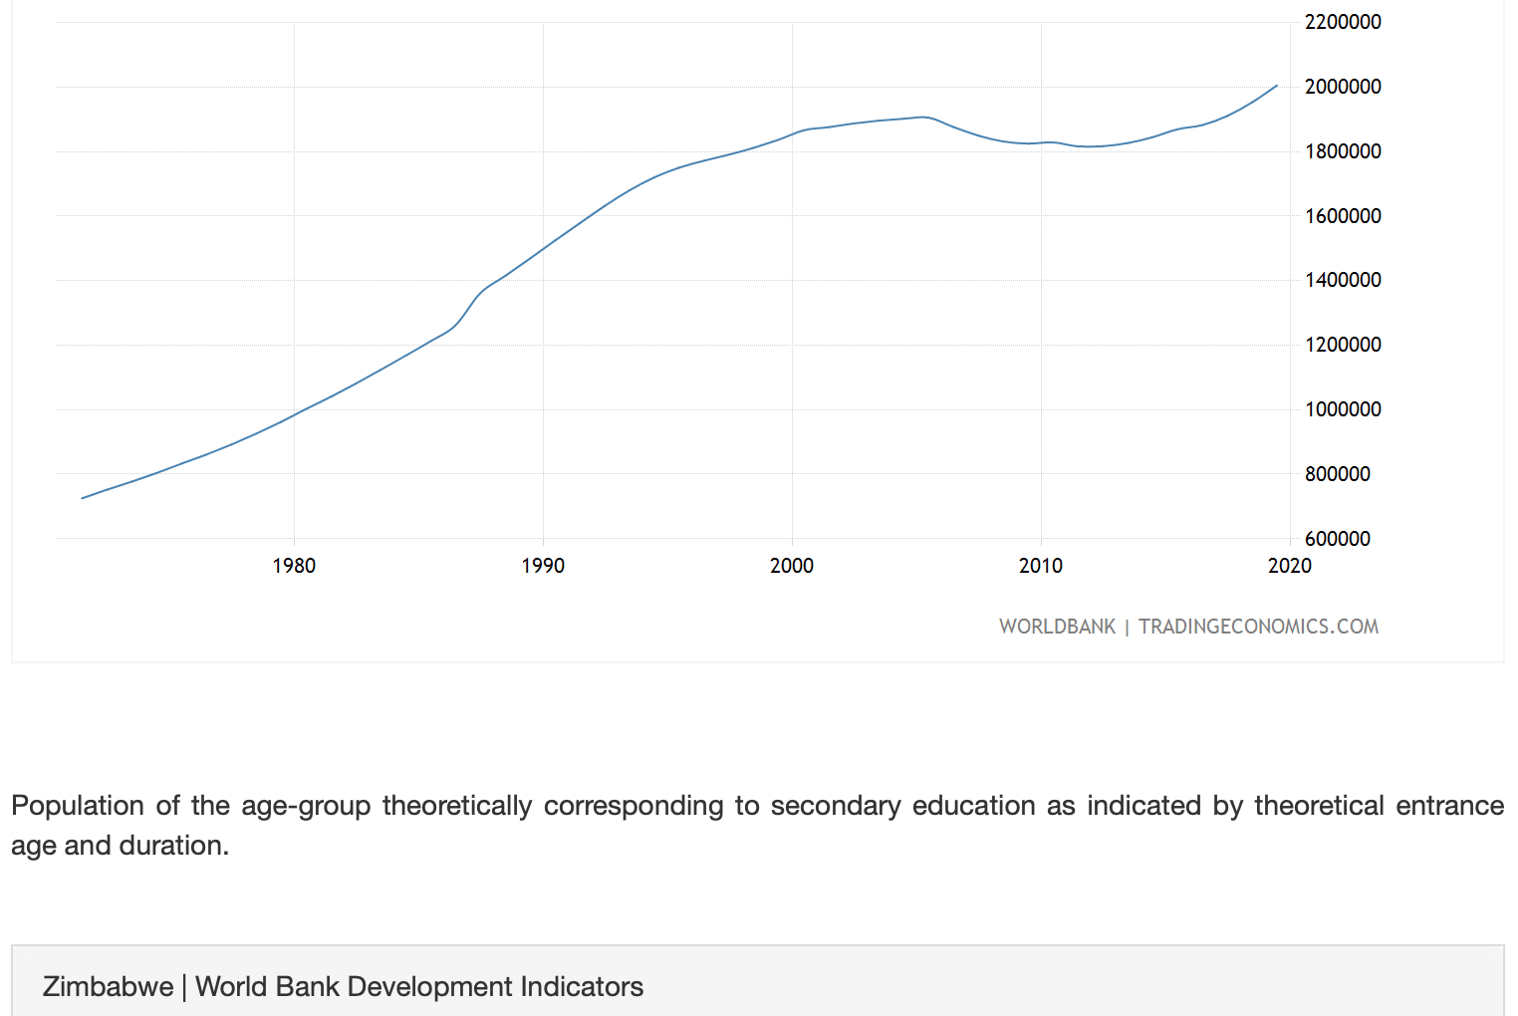
ADULT LITERACY (% POPULATION)
School Enrollment, secondary

Slide 6
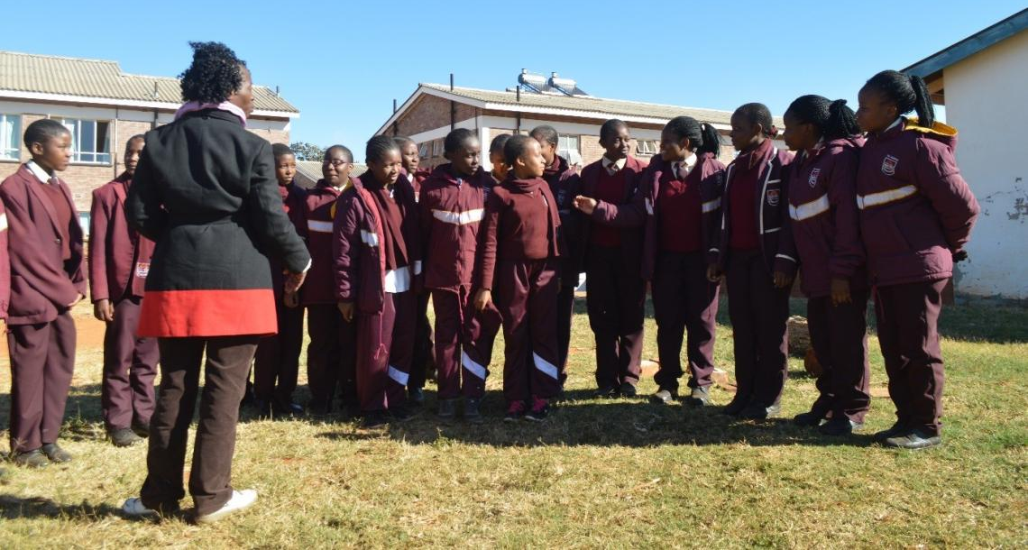
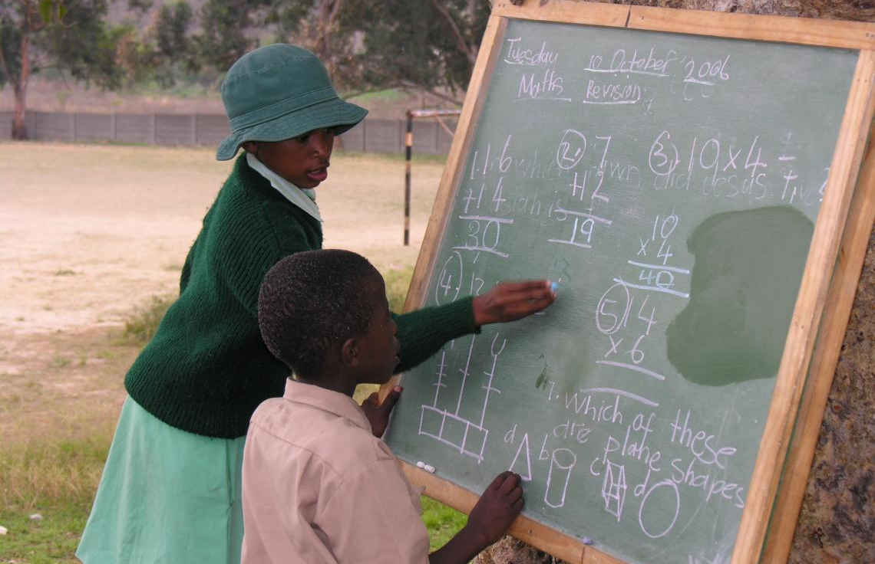
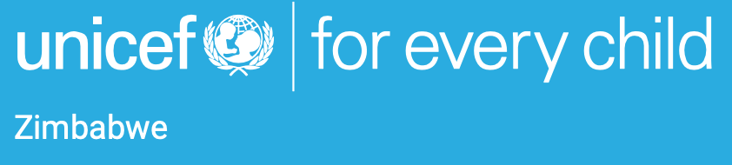

Slide 7
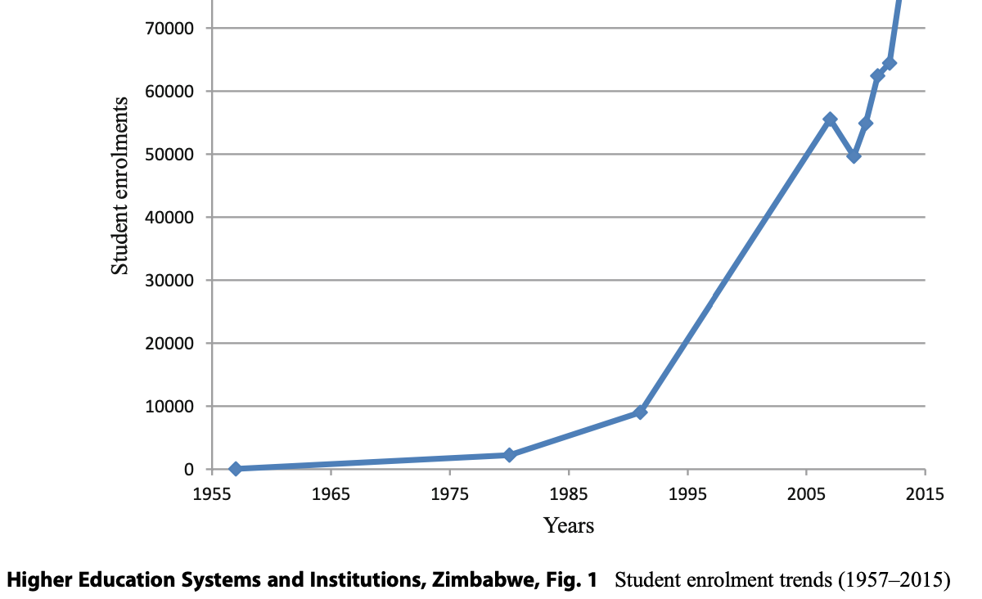
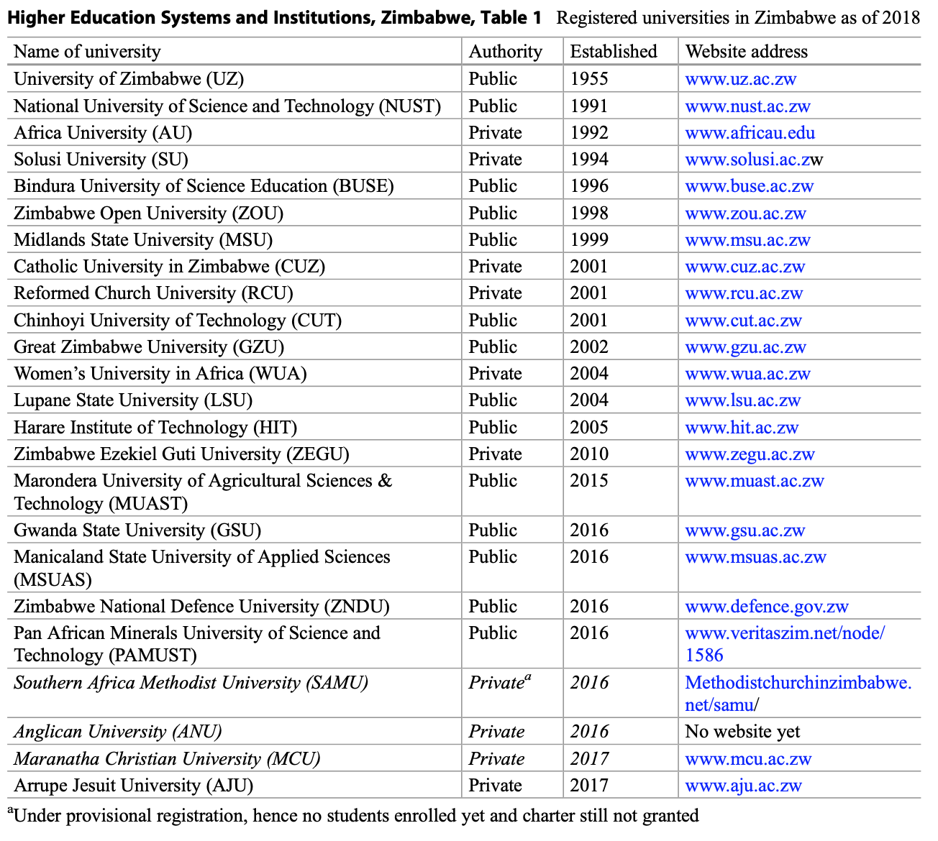


Slide 8
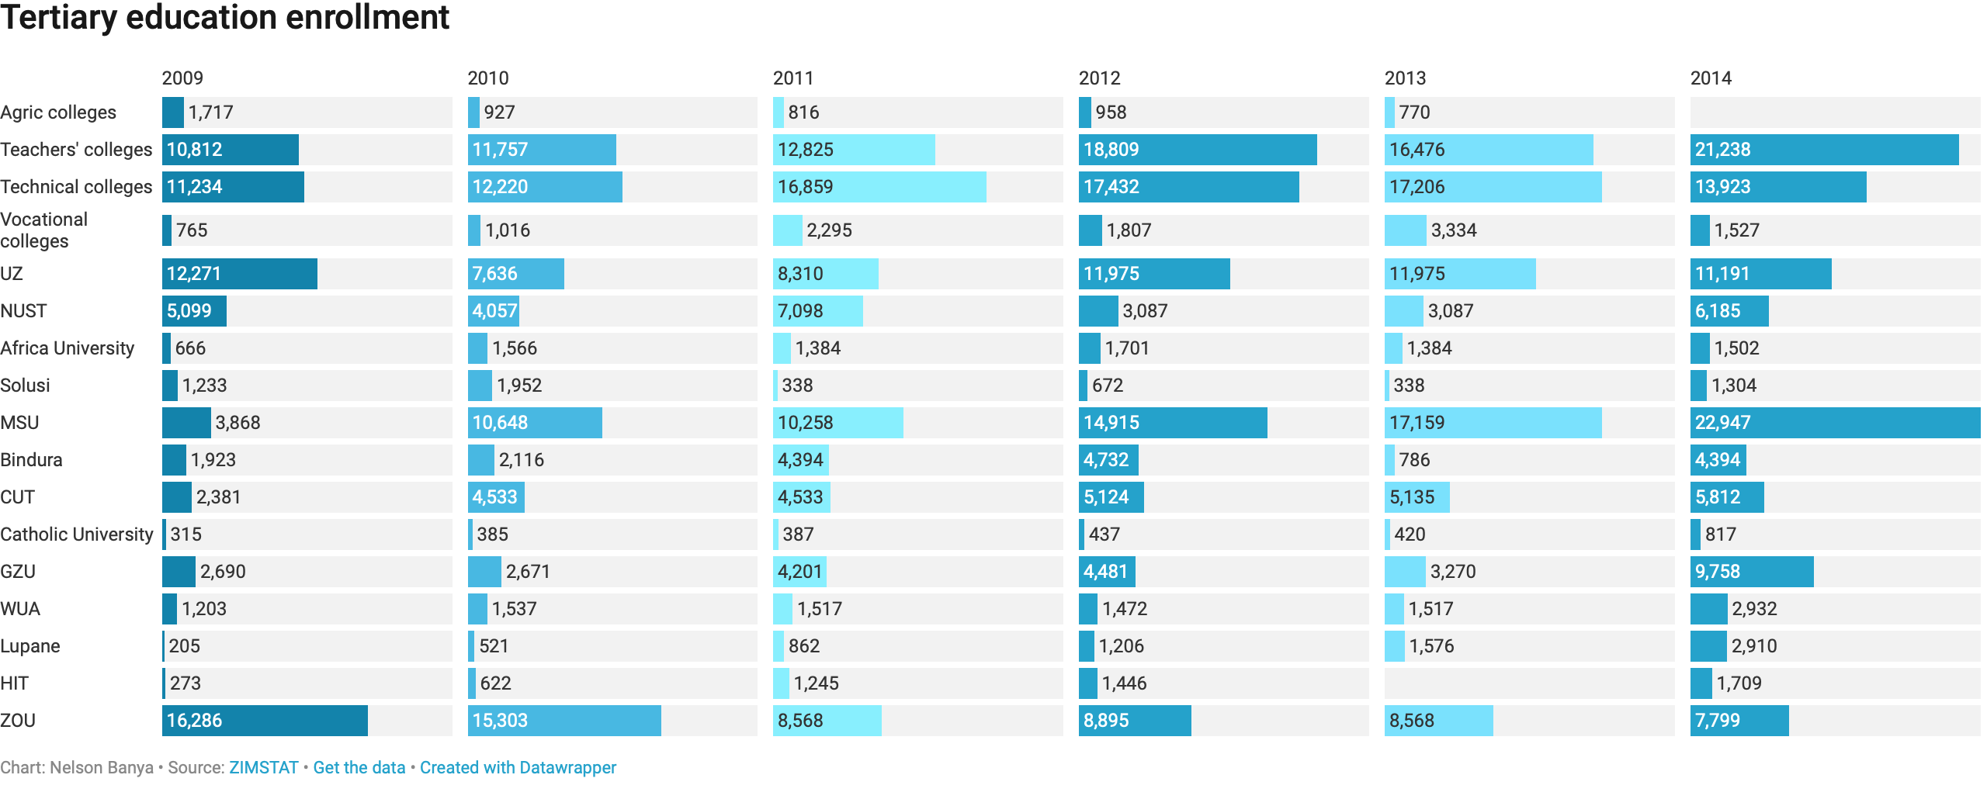


Slide 9
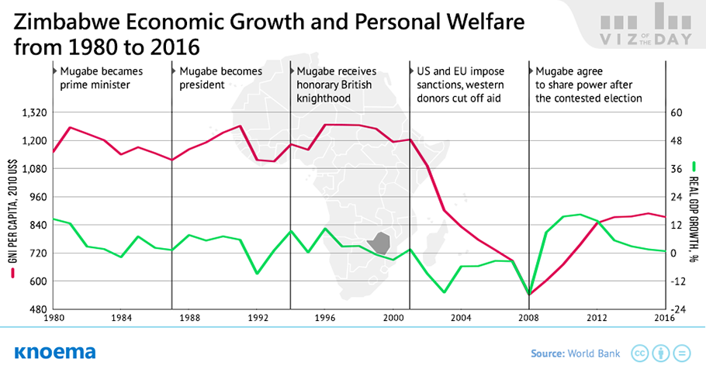
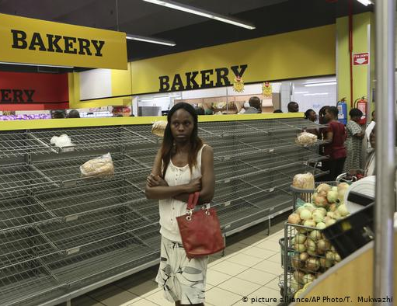
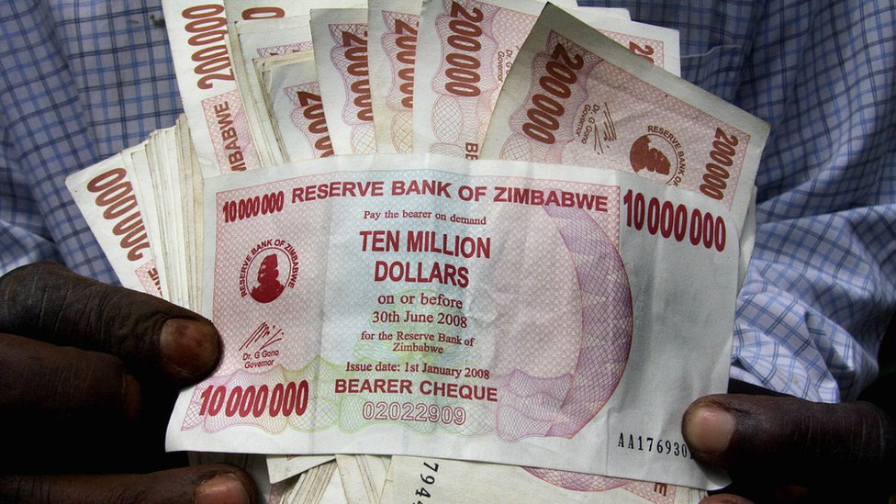
Economic crisis

Slide 10
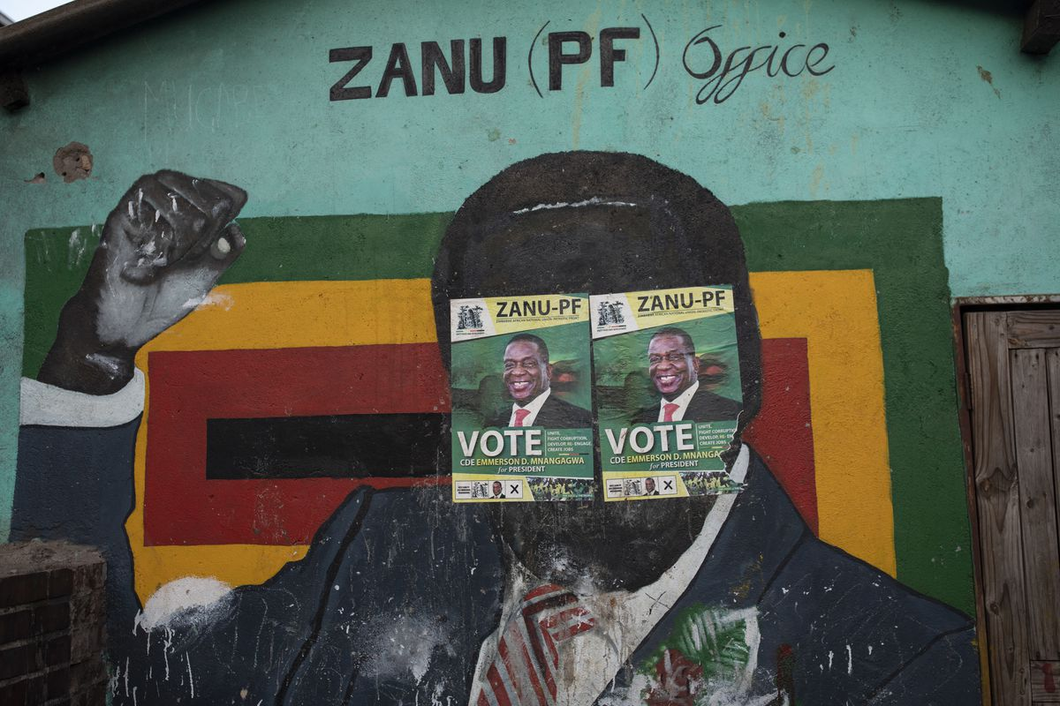

Slide 11
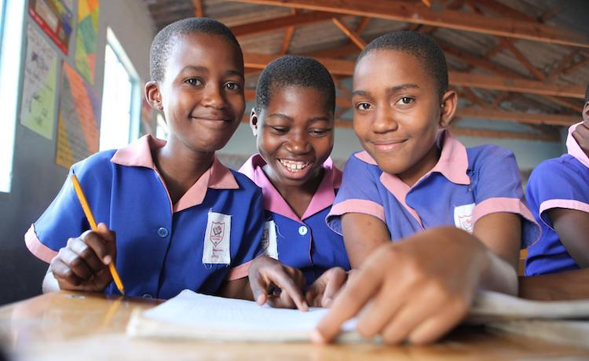

Slide 12
Zimbabwe covid-19 lockdown

Slide 14
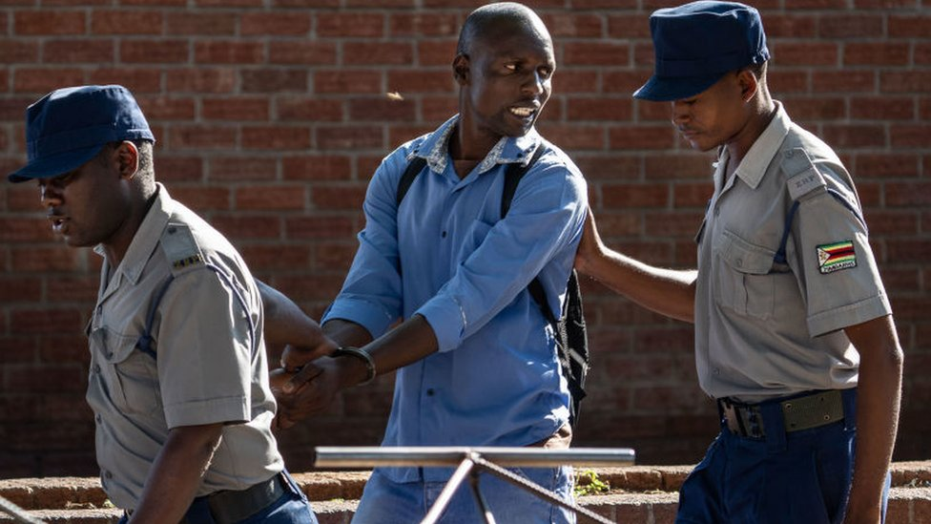
Covid-19 lockdown arrests

Slide 15
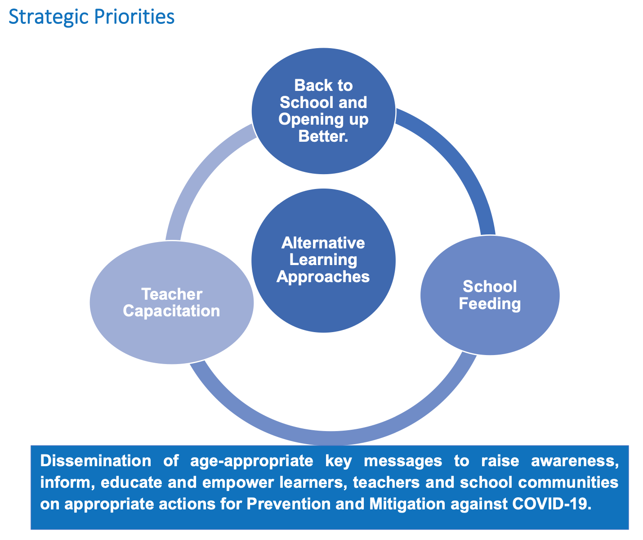
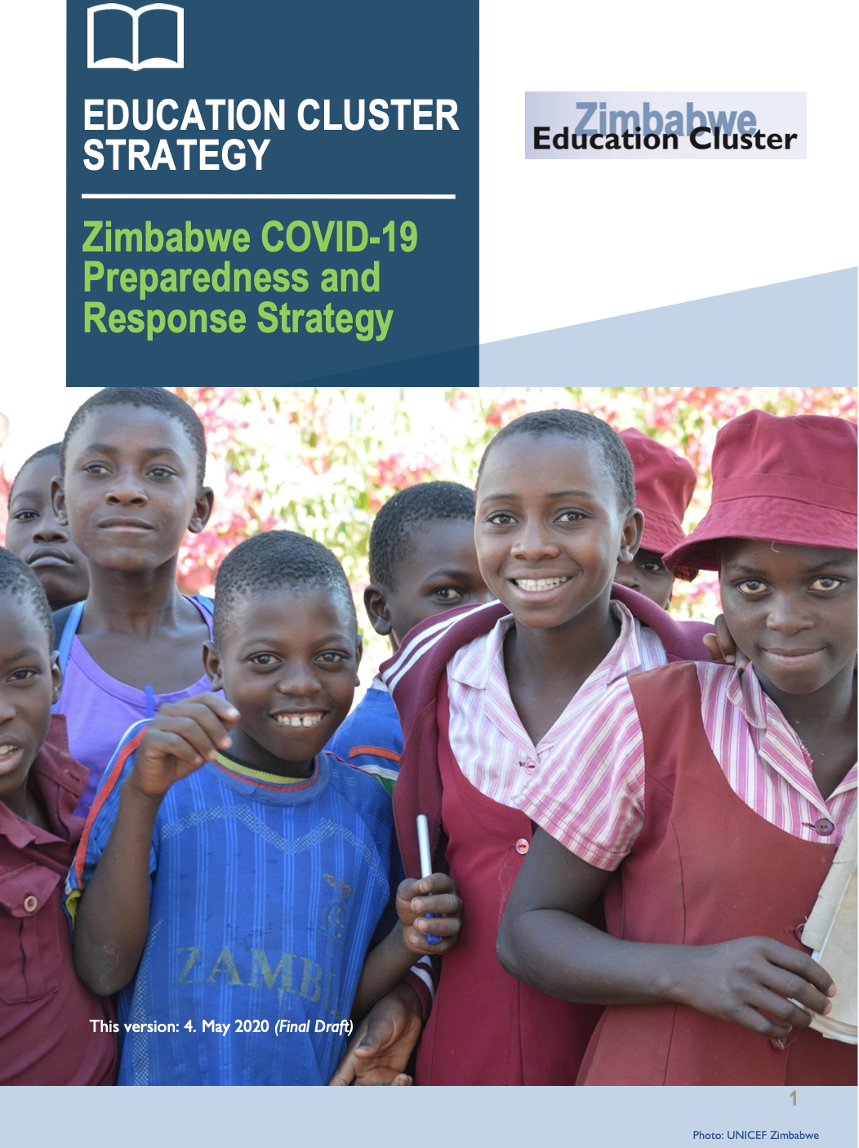

Slide 16
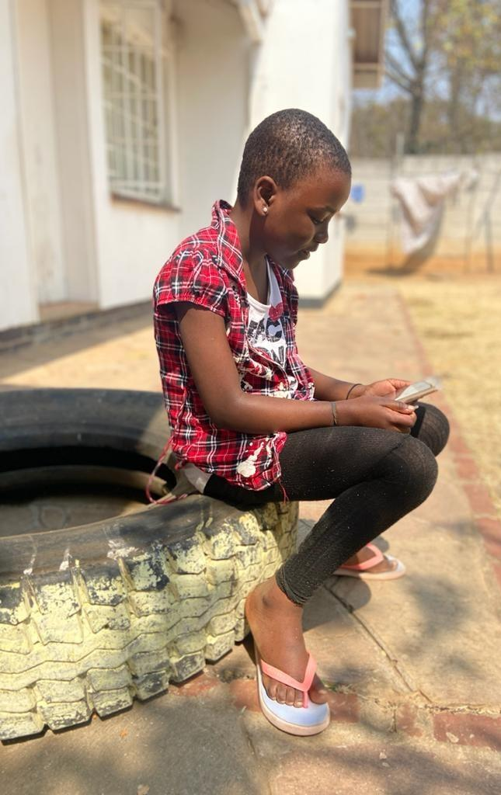
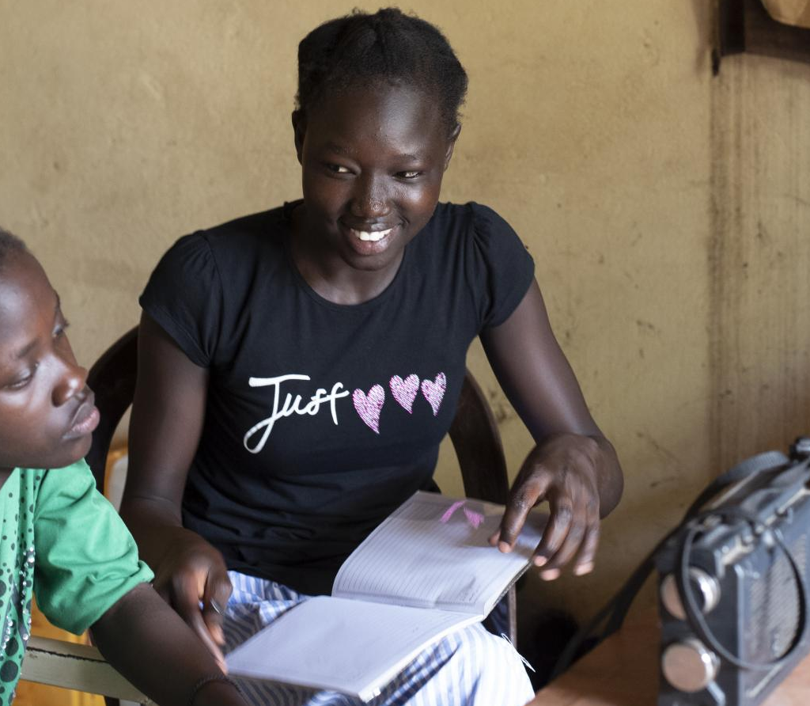
K-12 remote learning

Slide 17
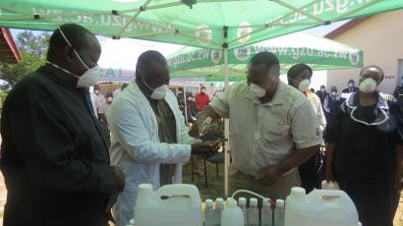

Slide 18
Students reject online learning as data costs hiked by 225% (MUKEREDZI, 2020)

Slide 19
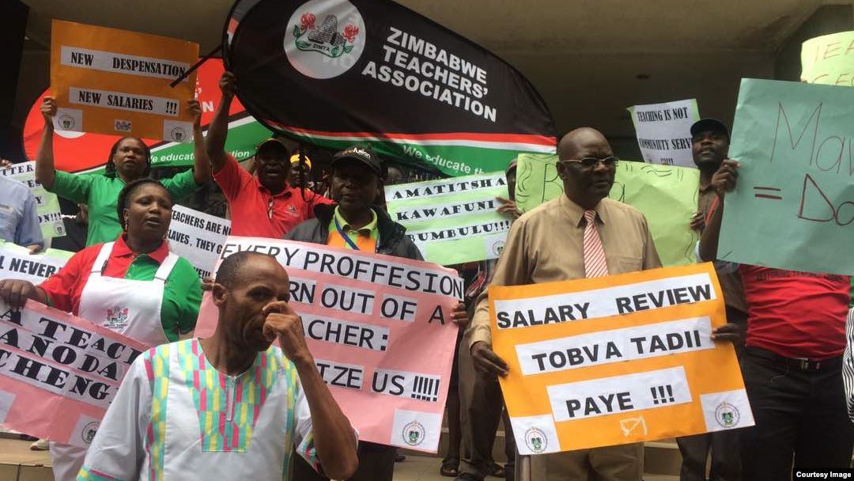

Slide 20
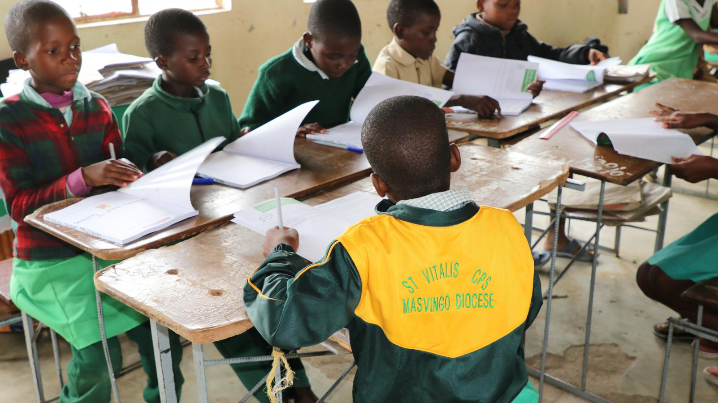

Slide 21
References
ALJAZEERA NEWS. (2020, August 25). It’s Now Illegal for Zimbabwe Schools to Expel Pregnant Girls. Breaking News, World News and Video from Al Jazeera. https://www.aljazeera.com/news/2020/8/25/its-now-illegal-for-zimbabwe-schools-to-expel-pregnant-girls
Bamhare, R. (2020, August 24). Iogt’s Storybooks Popular With Young Learners. UNICEF. https://www.unicef.org/zimbabwe/stories/iogts-storybooks-popular-young-learners
BBC News. (2020, July 19). Coronavirus: Zimbabwe Arrests 100,000 for 'Violations' of Measures. Retrieved October 4, 2020, from https://www.bbc.com/news/topics/crr7mlg0rpvt/zimbabwe
BBC. (2019, March 19). Zimbabwe Profile - Timeline. BBC News. https://www.bbc.com/news/world-africa-14113618
Central Intelligence Agency. (2020, September 29). Africa: Zimbabwe — The World Factbook. Welcome to the CIA Web Site — Central Intelligence Agency. Retrieved October 4, 2020, from https://www.cia.gov/library/publications/the-world-factbook/geos/zi.html
Garwe, E. C., & Thondhlana, J. (2018). Higher education systems and institutions, Zimbabwe. Encyclopedia of International Higher Education Systems and Institutions, 1-11. https://doi.org/10.1007/978-94-017-9553-1_479-1
Gavin, M. (2020, June 18). The authoritarian politics of COVID-19 in Zimbabwe. Council on Foreign Relations. https://www.cfr.org/blog/authoritarian-politics-covid-19-zimbabwe
Knoema. (2018, February 1). How Did Zimbabwe Change Over 37 Years of Robert Mugabe's Rule?https://knoema.com/infographics/olumvzc/how-did-zimbabwe-change-over-37-years-of-robert-mugabe-s-rule
Matiashe, F. S. (2020, April 1). Zimbabwe’s Universities are Manufacturing Masks, Gloves and Hand Sanitizers to Beat Coronavirus. Quartz Africa. https://qz.com/africa/1830380/coronavirus-zimbabwe-universities-making-face-masks-gloves/
Ministry of Primary and Secondary Education. (2020, May 4). EDUCATION CLUSTER STRATEGY Zimbabwe COVID-19 Preparedness and Response Strategyv. Planipolis. https://planipolis.iiep.unesco.org/sites/planipolis/files/ressources/zimbabwe_education_cluster_covid_strategy_12.05.2020_final.pdf
Mokwetsi, J. (2020, September 3). Radio Lessons Provide Much Needed Continuity in Learning Amid the Covid-19 Pandemic. UNICEF. https://www.unicef.org/zimbabwe/stories/radio-lessons-provide-needed-continuity-learning-amid-covid-19-pandemic
Mukeredzi, T. (2020, May 4). Students Reject Online Learning as Data Costs Hiked By 225%. University World News. https://www.universityworldnews.com/post.php?story=20200504142003239
Pindula. (2019, February 19). Education in Zimbabwe. Retrieved October 4, 2020, from https://www.pindula.co.zw/Education_in_Zimbabwe
Pintak, L. (2019, September 6). I Met Robert Mugabe in the Late 1970s. What He Told Me Still Haunts Me. Vox. https://www.vox.com/world/2019/9/6/20853400/robert-mugabe-dead-zimbabwe-president-zanu-pf
TradingEconomics. (2015). Zimbabwe - School enrollment, tertiary (% gross) - 1971-2015 data | 2020 forecast. TRADING ECONOMICS | 20 million INDICATORS FROM 196 COUNTRIES. https://tradingeconomics.com/zimbabwe/school-enrollment-tertiary-percent-gross-wb-data.html
TRADINGECONOMICS. (n.d.). Zimbabwe - Literacy rate, adult total (% of people ages 15 and above) - 1982-2015 data | 2020 forecast. TRADING ECONOMICS | 20 million INDICATORS FROM 196 COUNTRIES. https://tradingeconomics.com/zimbabwe/literacy-rate-adult-total-percent-of-people-ages-15-and-above-wb-data.html
Tsiko, S. (2018, March 13). Where Does Zimbabwe’s Education Stand? ZimFact. https://zimfact.org/factsheet-where-does-zimbabwes-education-stand/
UNICEF. (2020). Zimbabwe - Education. https://www.unicef.org/zimbabwe/education
Vives, L. (2020, March 10). New Laws Allow Zimbabwe to Fine or Jail to Keep Kids in School. IDN-InDepthNews | Analysis That Matters. https://www.indepthnews.net/index.php/the-world/africa/3371-new-laws-allow-zimbabwe-to-fine-or-jail-to-keep-kids-in-school
VOA. (2020, October 2). 100,000 Zimbabwe Teachers Boycott Schools Over Low Pay, Covid-19 Fears. Voice of America. https://www.voazimbabwe.com/amp/zimbabwe-teachers-boycotting-schools-over-low-pay-covid-19-fears/5605890.html
The World Bank. (2015). School Enrollment, Primary (% net) - Zimbabwe. World Bank Open Data | Data. https://data.worldbank.org/indicator/SE.PRM.NENR?locations=ZW

